Slide 1
What is the Covenant?
A promise from the nation to ensure that those who serve, those who have served and their families are treated fairly.
No disadvantage in accessing goods and services
Special consideration is appropriate in some cases (such as bereaved and injured)
Covenant
in Business
Covenant across Government
Covenant
in the
Community
Covenant
in
Business
The Covenant
Fund
Notes:
The two principles act as the foundation on which we can build policy - To appreciate why the Covenant is structured as it is you only have to think about where and why disadvantage arise – mobility, postings overseas, transition to civilian life – these all impact on the roles of Central and Local Government, Businesses and the Charitable sector – And so our work in central Government are focussed on these different areas.
The boxes represent a different area of activity but all delivering the Covenant - we’ll talk about the community and the covenant fund but worth remembering other work going on –
Across Gov: Inter-Ministerial Group and CRG, written into NHS constitution, AF champs in regional job centres etc
Commercial disadvantage successes - Mortgages: 29 of the UK’s largest banks and building societies have committed to allow service personnel and their families to rent out their home when abroad without incurring the extra fees. Junior ISAs: We have worked with the banks and building societies to improve access to Junior ISA accounts for dependants of crown servants based overseas. Mobile phone providers: agreeing to waive cancellation fees when SP posted overseas. Motor insurance: 86% of the UK’s motor insurance industry, by number of customers, has committed to waive cancellation fees and preserve no claims discounts for up to three years when service personnel and their families are posted abroad. Financial Services Steering group established to examine ways to remove commercial disadvantage. Online Survey launched to capture evidence of further commercial disadvantage SP/families may face. Next steps – Broadband, Health and Life Insurance, Buy-to-let mortgage Delivery charges to BFPO addresses, Credit History

Slide 2
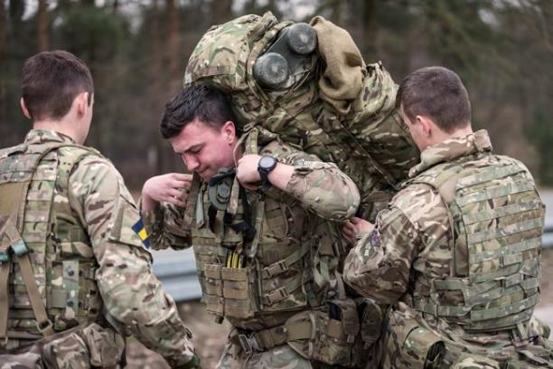
Who is it for?
Service Personnel
Service Families
Veterans
Covenant
in Business
Notes:
The Covenant is for Service Personnel, their families and the veteran community. There are over 2million people in the wider Armed Forces Community!

Slide 3
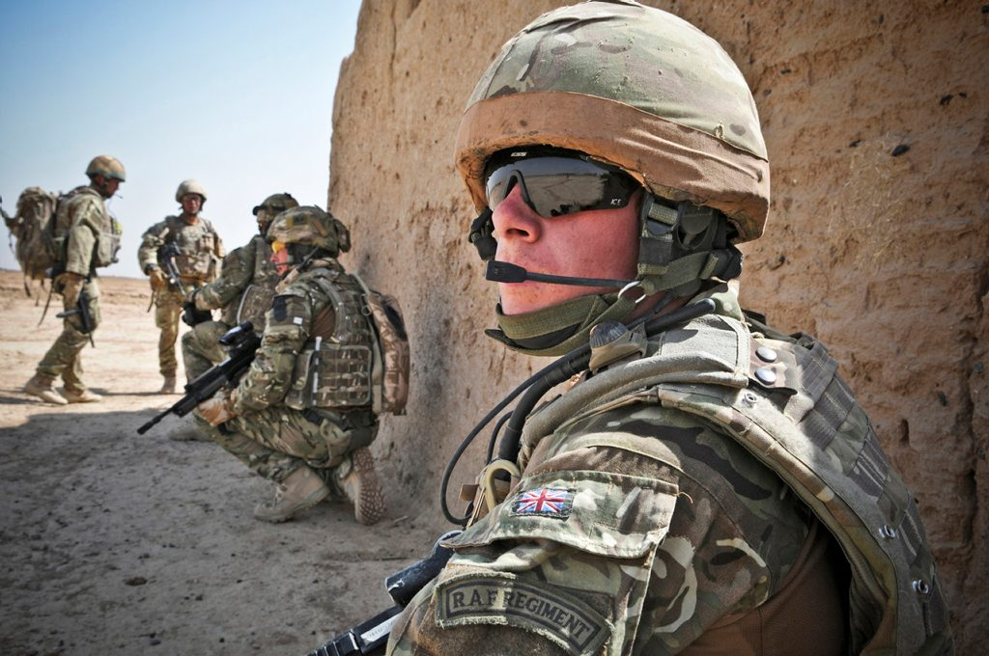
Why do we need it?
Operations in recent years:
Northern Ireland (1969-2007)
Falklands War (1982)
Gulf War 1 (1990-1991)
Bosnia (1992-1995)
Kosovo (1998-1999)
Sierra Leone (2000)
Afghanistan/Herrick (2001-2014)
Gulf War 2/Telic(2003-2014)
Covenant
in Business

Slide 4
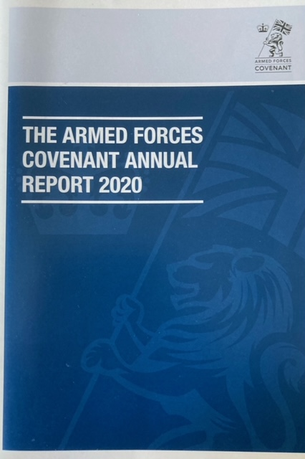
Background
2000
Soldiering – The military Covenant
2011
The Armed Forces Covenant Today and Tomorrow
Armed Forces Act brought the Covenant into
legislation for the first time
Annual Report to Parliament
2021
Strengthening the Covenant in law – Armed Forces Act
Covenant
in Business

Slide 5
What has it achieved?
Commercial
BFPO addresses now recognised by many more companies
MOD has been working with credit agencies to try and ensure SP aren’t disadvantaged
SP are now able to avoid cancellation charges on mobile phones and internet subscriptions when posted overseas
Car insurers will hold a no claims bonus for 3 years if a SP is posted overseas
Most mortgage lenders now allow Service Personnel to transfer to buy to let mortgage at no cost if posted
3 Credit Unions aimed at Service Personnel now exist, to encourage regular saving and provide access to cheap loans.
Covenant
in Business

Slide 6
What has it achieved?
Housing
Forces Help to Buy Scheme introduced in 2014 and will run until Dec 2022. SP can borrow up to £25k interest free for a deposit. 20,000 personnel have been lent approx £300M so far
Single Living Accommodation has been improved
Significant upgrades to Service Family Accommodation
Surplus SFA can now be occupied by SP in long term relationships
Future Accommodation Model being trialled in 3 locations. It provides much more flexible accommodation choices for all SP
Local Authorities no longer require proof of a local connection for former service personnel wishing to settle in an area and get social housing.

Slide 7
What has it achieved?
Families
Families Strategy introduced
Spousal Employment initiative with Family Federations to help service spouses find jobs
The Service Pupil Premium pays out around £23m per year to schools with Service Children on their roll.
Service spouses can now claim National Insurance credits for time spent on overseas tours.
Service Personnel are now able to apply for Flexible Working to suit family life.

Slide 8
What has it achieved?
Veterans
Office for Veterans Affairs created in 2019
Regular liaison with devolved administrations in Wales, Scotland and Northern Ireland over access to affordable housing for veterans
Veterans Gateway introduced to provide a “one stop shop” for veterans
Close liaison with the NHS has increased awareness of the needs of veterans among GPs
Veterans should receive priority treatment for service related conditions
Defence Transition Services introduced to provide additional support to help vulnerable Service Personnel make the transition to civilian life.
Covenant
in Business

Slide 9
More information from:
Covenant
in Business

Slide 10
What’s coming up?
Strengthening the Covenant in Legislation
NHS England to consider ways of improving access to healthcare for service families regardless of where they live
Toolkit to be launched to help schools provide better support to Service Children
We are continue to work with the DfE to review the Schools Admission Code with the aim of ensuring that there is particular reference to Service Children.
MOD’s Wrap Around Childcare pilots now include Catterick and Plymouth

Slide 11
Contact the Covenant team
COVENANT-MAILBOX@mod.gov.uk

