Slide 1


The Armed Forces Covenant Duty

Slide 2

Why do we need it?
Some useful hints & tips to how you can use
this presentation pack
This presentation pack is based on the webinars that the MOD’s Covenant team delivered across the UK, and contains a range of information covering the areas of health, education and housing, and a variety of case studies which explore how the Covenant Duty works in practice.
This pack can be used to inform yourself but also to help raise awareness about the Covenant and its legal Duty among your stakeholders. Please feel free to tailor the slides to meet the needs of your local area and/or subject matter so it is more relevant to your audience.
We suggest the following slides could be tailored to suit your area:
Slide 5 – you can use local examples of Covenant delivery as well as the national initiatives already included.
Slides 13-28 – the case studies. Choose the ones that are most relevant to your audience (we don’t suggest that you use all 16) or you might have some local ones to substitute.
Slides 31-33 – the screen shots of the inside of the Statutory Guidance. Choose either health, education or housing, whichever is most appropriate to your audience.
Please note that more detail is provided in the speaking notes which also gives the appropriate responses to the questions raised in the case studies.

Slide 3
Why do we need it?
Content Overview
The Armed Forces Covenant
The Armed Forces Covenant Duty
The Armed Forces Covenant Duty – In Practice
The Statutory Guidance
Other Support
Notes:
Content outline of what will be discussed in this presentation.

Slide 4

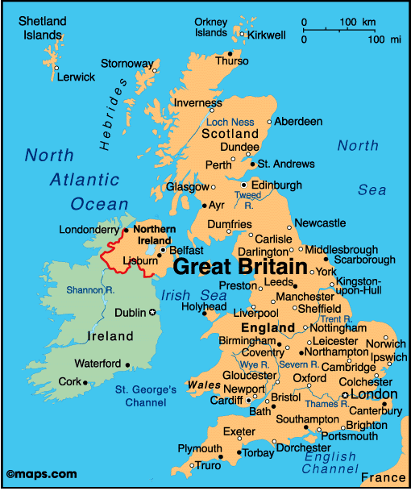


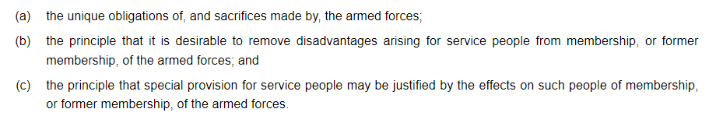
Notes:
The Armed Forces Covenant applies throughout the UK and is delivered across all sectors of society. As such, its implementation is shaped by local and regional factors and jurisdictions to optimise local support. In central Government, the MOD is the lead Department for the Covenant. As many of the levers for supporting the Armed Forces community sit with other Government Departments, the Devolved Administrations and Local Authorities, MOD works closely with them and others in the public, charitable and private sectors to deliver the Covenant. Local Government play a key role in delivering the Covenant on the ground. To date, every local authority in Great Britain has made a pledge to support the Armed Forces community.
The Covenant is focused on preventing the disadvantages that our Armed Forces community can face when accessing goods and services. For instance, this year, the MOD’s Education Support Fund provided £2 million worth of grants to 75 schools across the UK to help them mitigate the impact of mobility and separation on Service children and their families.
Covenant delivery is supported by the £10M per year Armed Forces Covenant Fund administered by the Armed Forces Covenant Fund Trust, an independent grant-making body with charitable status. More information about the Trust's work can be found at Armed Forces Covenant Fund Trust
Over the last eleven years, the Covenant has led to many activities and initiatives which have contributed to improvements in the lives of the Armed Forces community.

Slide 5
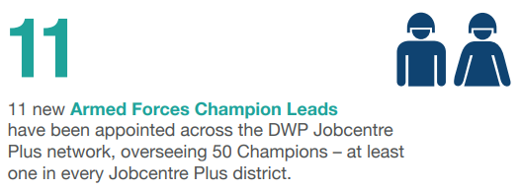




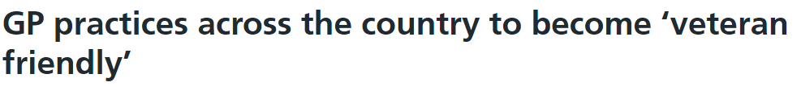
Veterans First Point: Drop-in services are available in six health areas in Scotland, developed by veterans and clinicians for veterans.
This offers a ‘one stop shop’ for help and assistance to veterans and their families, no matter what that need might be.
NI Veterans’ Support Office: Establishment of NIVSO as a first point of contact, information and advice for veterans in Northern Ireland.
East Lothian Council created some brand-new properties specially for veterans.
Supporting Service Children in Education (SSCE) Cymru, works with schools, children, local authorities, Armed Forces families to build networks across Wales to raise awareness and understanding of the experiences of Service children.
GP Practices across the country to become ‘veteran friendly’.
Notes:
Over the last eleven years, the Covenant has led to many activities and initiatives which have contributed to improvements in the lives of Armed Forces personnel, veterans and their families. For instance, last year, 11 new AF Champion Leads were appointed across Jobcentres, responsible for supporting veterans into work. Additionally, the Service Pupil Premium funded around 80,000 students.
In the Healthcare space – we have seen a Quality Network for Veterans Mental Health Services created, which promotes quality improvement within mental health services across the UK through the adoption of a multi-disciplinary approach, including the sharing of best practice.
You may have heard of Op Courage, launched in March 2021, the tiered service brings together all three veterans’ mental health services – the Transition, Intervention and Liaison Service (TILS), the Complex Treatment Service (CTS), and the High Intensity Service. Together, these services provide a complete mental health care pathway for Service leavers, reservists and veterans, with service users benefiting from personalised care plans to ensure that they can access support and treatment.
The Veterans Covenant Healthcare Alliance is an accreditation process for providers of NHS commissioned services. It aims to improve the care the Armed Forces community receives from the NHS, as well as raise standards across the NHS for all. At the end of the reporting period for the CAR 2021, 97 providers across the UK had met these standards and have been accredited as ‘veteran aware’, including acute hospitals, ambulance services and mental health and community Trusts.
In partnership with the Royal College of General Practitioners, NHS England and NHS Improvement continue to roll out the Armed Forces ‘veteran-friendly’ GP practice accreditation scheme across England. The scheme, which was rolled out across England in 2019, helps family doctors and their staff to better identify and treat veterans and other members of the Armed Forces community. By the end of the reporting period, 1,050 GP surgeries had been accredited as ‘veteran friendly’ (up from 780 at the beginning of the period). NHS England and NHS Improvement’s ambition is that all primary care networks will have at least one accredited practice

Slide 6

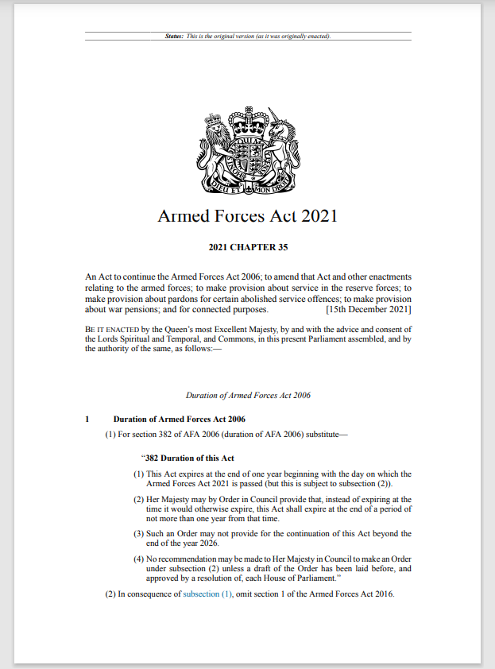
The Covenant Duty
Notes:
The Government, through the Armed Forces Act 2021, has strengthened the Covenant by creating an Armed Forces Covenant legal Duty, to better prevent the disadvantage faced by the Armed Forces community due to the unique nature of service life.

Slide 7




Why do we need it?
Why do we need it?
To build on the good work and delivery in support of the Armed Forces Community.
Members of the Armed Forces Community are still facing disadvantage in accessing public goods and services.
There remains a disparity in awareness of the Covenant and the issues that the AF Community face around the country.
To improve the Armed Forces’ lived experience, by increasing awareness of disadvantages they can face and how they can be resolved.
Notes:
Why do we need the Covenant Duty?
It is to build on the good foundation already there and to better support our Armed Forces community.
But there is still more work to do as some still do face disadvantages when accessing public services. Often caused by a lack of awareness among service deliverers and policy makers of the unique obligations and circumstances facing the Armed Forces community.
There remains a disparity, both in terms of awareness of the Covenant, and issues that the Armed Forces community face as they move around the country.
By increasing awareness, thought can be given to how they can be resolved and this will improve the lived experience of the Armed Forces community.
It is important to note that when we talk about disadvantage, we mean in comparison with the local population and their experience of accessing local services. In addition, any disadvantage must relate to an aspect of service life for it to be relevant to the Duty. For example, [Service families may be unable to take holidays, or spend time together, during normal school holiday periods and Service children might find they have limited time to spend with their serving parent(s) if the parent can only return home during term-time. The Service family might therefore ask the school for permission to take a holiday during term-time]. By embedding an understanding of these disadvantages in public sector decision-making, through the statutory duty to have due regard to the Covenant, this legislation will help improve overall delivery of public services in relation to the Armed Forces community.

Slide 8
What is the Covenant Duty?
A legal obligation on certain public bodies
to have due regard
to the principles of the Armed Forces Covenant
when carrying out certain functions
in healthcare, housing and education.
For example: in healthcare, bodies such as the National Health Service​ dealing with healthcare waiting list policies.
For example: in housing, bodies such as local authorities​ dealing with the allocation of social housing.
For example: in education, bodies such as schools and academies​ dealing with the school’s admissions criteria.
The bodies subject to the Duty are expected to consciously consider the Covenant when developing, delivering and reviewing policies and decisions which may impact the Armed Forces Community.
It means placing appropriate weight on the Covenant principles when all relevant factors are considered.
It does not mean that any particular conclusions have to be reached or specific public service delivery outcomes achieved.
Notes:
The Covenant Duty is a legal obligation on certain public bodies to have due regard to the principles of the Armed Forces Covenant when carrying out certain functions in healthcare, housing and education.
Examples: in healthcare – waiting list policies; in housing – allocation of social housing; education – school’s admission criteria.
The bodies in scope of the Duty are expected to consciously consider the Armed Forces Covenant when developing, delivering, reviewing policies and making decisions which may impact the Armed Forces community. Legislation does not state what in-scope bodies must do in order to have due regard, it is a matter for them. Ultimately, it’s about informed decision-making. Therefore, when carrying out relevant functions think about the principles of the AF Covenant, consider what mechanisms prompt decision-makers to assess how their decision might impact on service users from the AF community.
Consider how compliance with other similar duties are met. The Statutory Guidance has examples of good practice. You may consider keeping written record of decision making to help demonstrate due regard, if challenged.
It does not mandate outcomes but it means that the Armed Forces community are taken into consideration and given a fair hearing. The Duty is flexible so local areas can meet needs of their local population.

Slide 9
Why do we need it?
Healthcare Bodies and Functions in Scope
Bodies
Functions
England:
  NHS England
  Integrated care boards
  NHS Trusts and NHS Foundation Trusts
  Local authorities
Wales:
  Local Health Boards and NHS Trusts
  Special Health Authorities
  Local authorities
Scotland:
  Integration authorities
  Health Boards and Special Health Boards
  The Common Services Agency for the Scottish Health Service
  Local authorities
Northern Ireland:
  The Department of Health (Northern Ireland), but only when exercising the relevant healthcare functions in scope
  Local Commissioning Groups
  Health and Social Care Trusts
Provision of services
Planning and funding
Co-operation between bodies and professionals
These healthcare functions are within scope of the Duty in the following settings:
NHS Primary Care services, including general practice, community pharmacies, NHS dental, NHS optometry services and public health screening services.
NHS Secondary Care services, including urgent and emergency care, hospital and community services, specialist care, mental health services, and additional needs services (as applicable).
Local authority-delivered healthcare services, including sexual health services and drug and alcohol misuse services.
Notes:
Participants to read the bodies in scope. Read out the functions in scope and explain that only functions within particular settings/context/circumstance are caught by the Duty.

Slide 10
Why do we need it?
Education Bodies and Functions in Scope
Bodies
Functions
England:
• Local authorities
• Governing bodies of maintained schools and further education institutions
• Proprietors of Academies
• Non-maintained special schools and special post-16 institutions
Wales:
• Local authorities
• Governing bodies of maintained schools
Scotland:
• Local authorities
• Persons or bodies whose help is requested under section 23 of the Education (Additional Support for Learning) (Scotland) Act 2004
N Ireland:
• The Education Authority and the Board of Governors of a grant-aided school
• Admissions
• Educational attainment and curriculum
• Child wellbeing
• Transport to/from school
• Attendance
• Additional needs support
• Use of Service Pupil Premium funding (England only)
These education functions are within scope of the Duty in compulsory education settings, that is, primary, secondary, and, for England only, compulsory further education.
The Duty does not cover nursery (early years education), higher education, or other voluntary adult education settings.
Notes:
Participants to read the bodies in scope for themselves. Read out the functions in scope and explain functions are relevant within certain settings/context/circumstances eg admissions in primary, secondary and (for England compulsory further education) so university admissions are not within scope of the Duty.

Slide 11
Why do we need it?
Housing Bodies and Functions in Scope
Bodies
Functions
England:
• Local authorities
Wales:
• Local authorities
Scotland:
• Local authorities and local authority landlords
Northern Ireland:
• The Northern Ireland Housing Executive
• Allocations policy for social housing
• Tenancy strategies (England only)
• Homelessness
• Disabled Facilities Grants
Notes:
Participants to read the bodies in scope. Read out the functions in scope.

Slide 12
Why do we need it?
The Covenant Duty in practice:
Questions to consider
● Are given circumstances covered by the Covenant Duty?
• Is the public body providing the service in scope of the Duty?
• Is the service they’re providing in scope of the Duty?
• Is the person affected a member of the Armed Forces community in scope of the Duty?
• Have they experienced a disadvantage compared to someone in a similar position who is not a member of the Armed Forces community, that has arisen from Service life?
• Or, are they someone for whom special provision could be justified? (Special provision is especially for those who have sacrificed the most, such as the injured and bereaved.)
● Has the organisation fulfilled its legal obligation under the Covenant Duty? What would you advise it to do?
Notes:
Let’s think about what this could look like in practice. We need to be able to decide: For given circumstances, are they in scope of the new Duty?
In general, there are criteria that need to be met for a scenario to be within scope:
-The public body providing the service needs to be generally within scope,
-The service they’re providing, or we say: the function they’re carrying out,
-The person affected, needs to be within scope.
-They need to have suffered a disadvantage…
-and for this to be due to Service life.
The 2nd aspect of the Covenant that needs to be considered is Special Provision.
Special Provision is doing something a bit extra, something that goes above & beyond removing a disadvantage, and is something that isn’t normally available to the general public and the rest of the AF community. And special provision is particularly for those who’ve sacrificed the most, such as the injured and bereaved.
And then, once we’ve decided that given circumstances are in scope, we need to decide what we advise the organisation to do. The following are scenarios that local authorities could be faced with, to help us see what this could look like in practice.

Slide 13
Why do we need it?
The Covenant Duty in practice: Healthcare 1
Amy is married to a soldier. She’s on an NHS waiting list with an 8-month waiting time.
After waiting 4 months, the Army requires them to re-locate. Amy’s treatment is transferred to a hospital at their new location, which also has an 8-month waiting time.
The hospital places Amy at the back of its 8-month waiting list, as this is what it does as a matter of policy for all its new patients.
● Does this scenario fall within scope of the Covenant Duty?
• Is the body providing the service within scope?
• Is allocation of waiting list places within scope?
• Is Amy within scope?
• Has Amy experienced a disadvantage?
• If so, has it arisen from Service life?
• Might special provision be appropriate here?
● Has the organisation fulfilled its legal obligation under the Covenant Duty? What would you advise it to do?
Notes:
Healthcare scenario 1: Amy
***Read through the scenario***
Allow for 30 seconds silence, to give attendees time to read through questions on the right hand side and think about what the answers would be.
• Is the body providing the service, the NHS body, within scope? Yes – NHS trusts and foundation trusts are listed in the legislation.
• Is allocation of waiting list places within scope? Yes – provision of services in the context of Secondary Healthcare.
• Is Amy within scope? Yes – partners of serving personnel are within scope, she’s an example of a ‘relevant family member’.
• Has Amy experienced a disadvantage? (Opportunity here to open discussion with audience). Yes – longer wait time for treatment than general population (12 months rather than 8)
• If so, has it arisen from Service life? Yes, the aspect of Service is geographic mobility.
We’ve met the criteria, so we would think that this example probably is within scope of the Duty.
Also: Don’t mix up the disadvantage and the cause of the disadvantage. Disadvantages are about worse access to goods & services. The aspects of Service life, such as having to regularly re-locate, are the cause of the disadvantage, not the disadvantage itself.
Might special provision be appropriate here? We don’t have enough information to know for sure, but it seems like Amy doesn’t fall within this category of being someone who’s sacrificed the most, so Special Provision probably not required here.
Has the NHS fulfilled its legal obligation under the Covenant Duty?
- We can’t be certain, but it seems like they haven’t considered the Covenant, they’ve just put her at the back of the waiting list, like everyone else, without giving it a second thought.
What would you advise it to do?
- The Duty is a Duty of due regard, so they legally must have due regard.
- What that means in practice is: Acknowledging that there’s a disadvantage here arising from Service life, that it’s desirable to remove it, and consider if it can remove it, or reduce it.
- Duty doesn’t define outcomes, so the same outcome could result, even after they’ve done this.
What could the NHS consider doing to remove the disadvantage?
- Consider moving Amy up the waiting list, allowing her to bring with her, her remaining waiting time from her previous location, to reflect time already waited.

Slide 14
Why do we need it?
The Covenant Duty in practice: Healthcare 2
Tom, the child of an RAF engineer, lives abroad with his serving parent. He is undergoing orthodontic treatment when they are posted back to the UK.
The original moulds of his teeth cannot be brought back to the UK, so it cannot be ascertained whether he would have met the NHS Index of Orthodontic Treatment Need criteria for treatment.
Therefore, he is refused approval for NHS treatment.
● Does this scenario fall within scope of the Covenant Duty?
• Is the body providing the service within scope?
• Is assessing treatment eligibility within scope?
• Is Tom within scope?
• Has Tom experienced a disadvantage?
• If so, has it arisen from Service life?
• Might special provision be appropriate here?
● Has the organisation fulfilled its legal obligation under the Covenant Duty? What would you advise it to do?
Notes:
Healthcare scenario 2: Tom
***Read through the scenario***
We’ve got the same questions as before on the right hand side.
● Does this scenario fall within scope of the Covenant Duty?
• Is the NHS body within scope? Dentistry is a bit more complicated – not the local dentist, but more broadly under NHS England, as the organisation commissioning NHS dental services. This was a real-life scenario, and it was NHS England that accepted it had a responsibility here.
• Is assessing treatment eligibility within scope? Yes – ‘provision of services’ again.
• Is Tom within scope? Yes – children of currently serving personnel are another type of ‘relevant family member’
• Has Tom experienced a disadvantage? Yes – What is the disadvantage? The NHS hasn’t been able to ascertain whether he would’ve met the NHS Index of Orthodontic Treatment Need criteria for treatment, which it would’ve done if he’d been a civilian in the general population.
• Has it arisen from Service life? Yes, the aspect of Service is geographic mobility – the Service requirement to be abroad.
This example is within scope of the Duty.
• Might special provision be appropriate here? Probably not, this doesn’t seem to be someone who’s sacrificed the most (FOR EXAMPLE the injured or bereaved).
● Has the NHS fulfilled its legal obligation under the Covenant Duty? - We can’t be certain, but it seems like they haven’t yet considered the Covenant.
What would you advise it to do? - As before, legally it must have due regard.
So acknowledging that there’s a disadvantage here arising from Service life, that it’s desirable to remove it, and consider if it can remove it, or reduce it.
The real-life outcome is that NHS England agreed the treatment could continue under NHS funding.

Slide 15
Why do we need it?
The Covenant Duty in practice: Healthcare 3
Deena is 12 years old and a member of the Army Cadets. She’s in the middle of a course of NHS orthodontic treatment when her family re-locates across the country so they can more easily care for an elderly relative.
Deena joins a waiting list in their new location to resume the treatment.
● Does this scenario fall within scope of the Covenant Duty?
• Is the body providing the service within scope?
• Is NHS orthodontic treatment within scope?
• Is Deena within scope?
• Has Deena experienced a disadvantage?
• If so, has it arisen from Service life?
• Might special provision be appropriate here?
● Has the organisation fulfilled its legal obligation under the Covenant Duty? What would you advise it to do?
Notes:
Healthcare scenario 3: Deena
***Read through the scenario***
We’ve got the same questions as before on the right hand side.
● Does this scenario fall within scope of the Covenant Duty?
• Is the NHS body within scope? Yes – NHS trusts are in scope
• Is NHS orthodontic treatment within scope? Yes
• Is Deena within scope. No, she’s a cadet, she’s not serving in the Armed Forces, as a Regular or Reserve,
So we can already stop, as we know this scenario is not covered by the Duty, but let’s carry on, to see what our answers would have been to the rest.
• Has Deena experienced a disadvantage, arising from Service life? While she has to stop receiving treatment, this hasn’t been caused by Service life, so even if Deena was in scope, this wouldn’t be a disadvantage under the Covenant that needs removing.
Might special provision be appropriate here? Probably not, this doesn’t seem to be someone who’s sacrificed the most.
● Has the NHS fulfilled its legal obligation under the Covenant Duty? - We can’t be certain, but it seems likely that it hasn’t.
What would you advise it to do? - No legal obligation on the NHS here. Wouldn’t advise it to do anything.
Can you think of any changes to this scenario that could lead to this being in scope?
If this was the child of someone serving, and the re-location was due to Service reasons.

Slide 16
Why do we need it?
The Covenant Duty in practice: Healthcare 4
Farah lost both arms while serving in the Army 20 years ago. He needs to have a blood sample taken.
However, the nurses are only trained to take blood from arms, so cannot take blood from him (or from any patient without arms).
He experiences a delay in receiving treatment.
● Does this scenario fall within scope of the Covenant Duty?
• Is the body providing the service within scope?
• Is taking blood samples within scope?
• Is Farah within scope?
• Has Farah experienced a disadvantage?
• If so, has it arisen from Service life?
• Might special provision be appropriate here?
● Has the organisation fulfilled its legal obligation under the Covenant Duty? What would you advise it to do?
Notes:
Healthcare scenario 4: Farah
***Read through the scenario***
We’ve got the same questions as before on the right hand side.
● Does this scenario fall within scope of the Covenant Duty?
• Is the NHS body within scope? Yes, there is an NHS body in scope. If this is happening in the hospital, it’s the Trust or Integrated Care Board the hospital is part of. If it’s in a GP surgery, it’s a bit more complicated, NHS England or the Trust that commissions the GP services would be in scope.
• Is taking blood samples within scope? Yes
• Is Farah within scope? Yes, he’s a veteran, a former member of the Armed Forces, and they are within scope.
• Has Farah experienced a disadvantage? Yes – delay receiving treatment compared to local population
• If so, has it arisen from Service life? Yes, from the loss of his arms! (The UO&S of danger)
We’ve got 5 ‘Yes’s, so this is within scope of the Duty, in terms of disadvantage.
Could it also be within scope in terms of special provision?:
• Might special provision be appropriate here? Yes, quite possibly, as he’s someone who’s sacrificed the most.
● Has the NHS fulfilled its legal obligation under the Covenant Duty? - We can’t be certain, but it seems likely they haven’t considered the Covenant.
- This is a real-life case
What would you advise it to do? - Acknowledge that there’s a disadvantage here arising from Service life, that it’s desirable to remove it, and consider if it can remove/reduce it.
For example, by finding another way to take the blood sample.
Broader NHS schemes specially for veterans, including the Veteran Trauma Network, Op COURAGE, Veterans’ Health Innovation Fund

Slide 17
Why do we need it?
The Covenant Duty in practice: Healthcare 5
Megan recently left the Navy. She's started suffering from insomnia, recurring nightmares related to an incident during her time in the Navy, and she's also started to drink a lot more.
She visits her GP, who refers her to an NHS sleep clinic and to a local authority alcohol support service.
● Does this scenario fall within scope of the Covenant Duty?
• Is the body providing the service within scope?
• Is allocation of waiting list places within scope?
• Is Megan within scope?
• Has Megan experienced a disadvantage?
• If so, has it arisen from Service life?
• Might special provision be appropriate here?
● Has the NHS fulfilled its legal obligation under the Covenant Duty? What would you advise it to do?
Notes:
Healthcare scenario 5: Megan
***Read through the scenario***
Does this scenario fall within scope of the Covenant Duty?
• Is the NHS body within scope? Yes – NHS trusts are in scope. It’s complicated for GPs, in that they can be independent to some degree, but given they take their direction from the NHS, there is a requirement on the Trusts to ensure their GPs are paying due regard to the Covenant.
• Is diagnosis of medical problems within scope? Yes – ‘provision of services’ in the context of Primary Healthcare on last slide
• Is Megan within scope? Yes – she’s a veteran.
• Has Megan experienced a disadvantage? Yes – What is the disadvantage? She’s less likely than the general population to be directed to the services that are most appropriate for them.
The point about this one is that Megan is displaying symptoms of PTSD, and the GP hasn’t identified that, or directed her to PTSD services. Potentially 3 issues here:
Healthcare professionals might not fully understand the healthcare conditions that can arise from Service, or they might not have experience of treating them. It’s a definite source of disadvantage for the Armed Forces community.
Secondly, this GP might not have known about services available to the Armed Forces community, so hasn’t directed Megan to the services most appropriate for her. In this case, the NHS in England runs a service called Op COURAGE which provides bespoke mental health treatments for veterans.
And thirdly, there’s a chance the GP doesn’t know she’s a veteran, which itself makes it less likely that she will be provided with the right kind of care.
• If so, has it arisen from Service life? Yes, the potential PTSD has arisen from Service life
This example is within scope of the Duty.
Might special provision be appropriate here? Very possibly, if this is PTSD, then she’s someone who has sacrificed the most – Op COURAGE could be the special provision.
● Has the NHS fulfilled its legal obligation under the Covenant Duty? - We can’t be certain, but it seems likely that it hasn’t.
What would you advise it to do?
Megan probably wouldn’t have complained in this situation, so it’s a wider point about NHS bodies generally working to improve healthcare professionals’ knowledge of healthcare conditions arising from Service, what healthcare services are available for veterans, and working to improve their identification of which of their patients are from the Armed Forces Community.
For example, there’s a veteran-friendly accreditation programme for GP surgeries run by the Royal College of General Practitioners.

Slide 18
Why do we need it?
The Covenant Duty in practice: Healthcare 6
A nearby RAF base has a high turnover rate, as Armed Forces personnel are posted to the base, with their families, for two-year assignments, then move away again.
Being unfamiliar with the local area, members of this Armed Forces community therefore often lack awareness of what healthcare and other support services are available locally, and are less likely to access those services.
● Does this scenario fall within scope of the Covenant Duty?
• Is the body providing the service within scope?
• Is information on local health services in scope?
• Is this Armed Forces community in scope?
• Have they experienced a disadvantage?
• If so, has it arisen from Service life?
• Might special provision be appropriate here?
● Has the local authority fulfilled its legal obligation under the Covenant Duty? What would you advise it to do?
Notes:
Healthcare scenario 6: RAF Base
***Read through the scenario***
We’ve got the same questions as before on the right hand side.
• Is the body providing the service within scope? Yes, local authorities are in scope in relation to the healthcare services they deliver.
• Is information on local health services within scope? Yes, providing information about local healthcare services is a service in scope.
• Is this Armed Forces community within scope? Yes, it’s currently serving personnel and their families, who are also in scope as ‘relevant family members’
• Have they experienced a disadvantage? Yes – What is the disadvantage? They have less knowledge of local services, and less likely to access them, or it’s harder for them to access them, than the local civilian population.
• If so, has it arisen from Service life? Yes, from the requirement on them to be mobile.
We’ve met the required criteria, so this example probably is within scope of the Duty.
Might special provision be appropriate here? It seems likely they are not members of the AF community who’ve sacrificed the most, so Special Provision probably not required here.
● Has the local authority fulfilled its legal obligation under the Covenant Duty? What would you advise it to do?
What could they consider doing to remove it?
- Ensure they have a good understanding of the healthcare needs of their local Armed Forces community, and what services are available, not just NHS but also provided by the third sector, for example, as well.
Look at how they provide information and signposting to the local AF community.
Contact the base to talk to them about what the needs are and have a discussion about how they could start to meet some of those needs.
Again, this is a real-life scenario, it’s what led to the creation of Forces Connect South East, which is a cross-border partnership of several local authorities. One of the things they produced was an app aimed at the Armed Forces, which is an easy-to-use and comprehensive directory of contacts and information.

Slide 19
Why do we need it?
The Covenant Duty in practice: Education 1
A Service family is re-located to a new area by the Army, in the middle of the school year. The two children are placed in two different schools in opposite directions from their Service Family Accommodation, each a significant distance away.
The non-serving parent has to take both to school. Due to the time this takes, one child gets to school an hour early each morning, and the non-serving parent is finding it hard to maintain their own employment.
● Does this scenario fall within scope of the Covenant Duty?
• Is the school or local authority within scope?
• Is home-to-school transport within scope?
• Are the children & non-serving parent in scope?
• Have they experienced a disadvantage?
• If so, has it arisen from Service life?
• Might special provision be appropriate here?
● Has the school or local authority fulfilled its legal obligation under the Covenant Duty? What would you advise them to do?
Notes:
Education scenario 1: Service family
***Read through the scenario***
Go through the questions on the right hand side and think about what your answers would be.
• Is the school or local council within scope? Yes, schools and local authorities are in scope.
• Is home-to-school transport within scope? Yes, transport to school is one of the functions in scope
• Are the children & non-serving parent in scope? Yes, children and partners of currently serving personnel are covered by the Duty, they’re examples of ‘relevant family members’
• Have they experienced a disadvantage? Yes, two potential disadvantages here:
-Further to travel to school compared to the non-Service children, and a much longer school day compared to most other local children.
-The parent finding it harder to maintain their own employment as a result.
- Is there also a disadvantage around child wellbeing?
• If so, has it arisen from Service life? Yes, from the requirement to re-locate for Service reasons.
We would think that this example probably is within scope of the Duty.
So might special provision be appropriate here? We don’t have enough information to know for sure, but it seems likely these are not members of the AF community who’ve sacrificed the most, so Special Provision probably not required here.
● Has the school or council fulfilled its legal obligation under the Covenant Duty?
- We can’t be certain, we haven’t heard any positive evidence that they have.
What would you advise it to do?
The Duty is a Duty of due regard, so legally they must have due regard.
What that means in practice is: Acknowledging that there’s potentially a disadvantage here arising from Service life, that it’s desirable to remove it, and consider if it can remove it, or reduce it.
Duty doesn’t define outcomes, so the same outcome could result, even after they’ve had this consideration.
What could the school or council consider doing to remove it?
- This might be mitigated through the normal application of the free school transport policy – one or both of the Service children might meet the eligibility criteria.
Bodies responsible for provide home to school transport might be able to use their discretionary powers to provide free or subsidised transport to Service children who do not meet the eligibility criteria.
Could one of the children have been allocated to a different school, so at least the 2 children are both travelling in the same direction each morning.
Apply the exemptions to class size limits that exist for Service children, to enable them to go to different schools nearer-by.
Could some sort of car share arrangement be set up, with another pupil coming from the same direction?
In England, the Service Pupil Premium is available to remove disadvantage, so could that funding be used to help mitigate this. Not a huge amount per child, but this could be a legitimate use for it.
Could one of the schools let their Service pupil stay behind later in the evening, so the parent can work later and they can be picked up later.
All sorts of things that could be considered, depending on the individual circumstances, such as the age of the children will make a big difference.

Slide 20
Why do we need it?
The Covenant Duty in practice: Education 2
Vishal is 16 years old, and a member of the Royal Navy Reserve. His father works long hours for an engineering company, so the family will be unable to take holiday together in the upcoming half-term.
Therefore, they ask his school for permission to take a term-time holiday, but the school does not agree.
● Does this scenario fall within scope of the Covenant Duty?
• Is the school within scope?
• Is term-time attendance within scope?
• Is Vishal within scope?
• Has Vishal experienced a disadvantage?
• If so, has it arisen from Service life?
• Might special provision be appropriate here?
● Has the school fulfilled its legal obligation under the Covenant Duty? What would you advise it to do?
Notes:
Education scenario 2: Vishal
***Read through the scenario***
Go through the same questions as before on the right hand side.
• Is the school within scope? Yes, schools and academies are in scope.
• Is term-time attendance within scope? Yes, as child wellbeing, transport to school, and educational attainment are all in scope, could argue it’s any of those.
• Is Vishal within scope? Yes, he’s a member of the Reserves.
• Has Vishal experienced a disadvantage, and has it arisen from Service life?
While Vishal is less able than his peers to take holiday with his family, but this has not been caused by Service life, so this is not a disadvantage under the Covenant that needs removing.
So might special provision be appropriate here? It doesn’t seem that he’s a member of the AF community who’s sacrificed the most, so Special Provision probably not required here.
So there’s no case for removing disadvantage, and no case for special provision, so this scenario is not covered by the Duty.
● Has the school fulfilled its legal obligation under the Covenant Duty?
No legal obligation on the school here. Wouldn’t advise it to do anything.
Think about what changes to this scenario could lead to this being in scope? If the father was in the Armed Forces, and spending months away on deployment, the family might not be able to take holiday during term time, but only when the father’s back from deployment, which could fall during term time.

Slide 21
Why do we need it?
The Covenant Duty in practice: Education 3
The Service children attending a secondary school cannot access the after-school clubs.
This is because the bus timetable does not enable the Service children, commuting from the local military base, to stay beyond the school day.
● Does this scenario fall within scope of the Covenant Duty?
• Is the school within scope?
• Is attending after-school clubs within scope?
• Are the children within scope?
• Have the children experienced a disadvantage?
• If so, has it arisen from Service life?
• Might special provision be appropriate here?
● Has the school fulfilled its legal obligation under the Covenant Duty? What would you advise it to do?
Notes:
Education scenario 3: After-school clubs.
***Read through the scenario***
By ‘Service children’ it means the children of people currently serving in the Armed Forces.
Go through the same questions as before on the right hand side.
• Is the school within scope? Yes, maintained schools and academies are in scope.
• Is attending after-school clubs within scope? Yes, as child wellbeing, transport to school, and educational attainment are all in scope, could argue it’s any of those
• Are the children within scope? Yes, children of currently serving personnel are covered by the Duty, they’re 1 type of what’s called ‘relevant family members’
• Have the children experienced a disadvantage? Yes – They’re less able to access the after-school clubs than their peers.
• If so, has it arisen from Service life? Yes, from the requirement to live on the military base.
We would think that this example probably is within scope of the Duty.
So might special provision be appropriate here? We don’t have enough information to know for sure, but it seems likely these are not members of the AF community who’ve sacrificed the most, so Special Provision probably not required here.
● Has the school fulfilled its legal obligation under the Covenant Duty?
- We can’t be certain, we haven’t heard any positive evidence that they have.
What would you advise it to do?
The Duty is a Duty of due regard, so legally they must have due regard.
What that means in practice is: Acknowledging that there’s potentially a disadvantage here arising from Service life, that it’s desirable to remove it, and consider if it can remove it, or reduce it.
Duty doesn’t define outcomes, so the same outcome could result, even after they’ve had this consideration.
Would be beneficial to keep a written record of how a decision was made, as evidence of having had due regard.
What could they consider doing to remove it? Could be resolved by various means, the Covenant has done its job and highlighted the issue.
Could they look at whether they could run the club at other times, such as lunch times, or before school.
Could talk to the military base about the military providing an extra, later bus after school
Could they talk to the local authority or the bus company to explain the situation and see if they can adjust their bus timetables. The bus company and the local authority won’t know about the issue unless the school tells them. The local authority is in scope of the Duty, and they have a role in setting bus services, so could there be a responsibility on them to see if they can make adjustments to the bus timetables.
Real-life case, the school liaised with a third party to set up an additional after-school club, joint with some other schools, on the military base, and also included non-Service children.
In England, the Service Pupil Premium is available to remove disadvantage, so could that funding be used to help mitigate this. Not a huge amount per child, but if there’s a lot of children, the amount could quickly multiply up, and this could be a legitimate use for it.

Slide 22
Why do we need it?
The Covenant Duty in practice: Education 4
Elisha, the child of an RAF pilot, is eligible for free home-to-school transport.
The RAF requires them to move home. Elisha can remain at the same school, but no longer qualifies for free transport, so the local council discontinues it.
Elisha’s parents have complained to the Local Government and Social Care Ombudsman, who’s requested evidence from the local council of how it has considered the Covenant.
● Does this scenario fall within scope of the Covenant Duty?
• Is the local authority within scope?
• Is home-to-school transport within scope?
• Is Elisha within scope?
• Has Elisha experienced a disadvantage?
• If so, has it arisen from Service life?
• Might special provision be appropriate here?
● Has the local authority fulfilled its legal obligation under the Duty? If it has, what kind of evidence could it rely on to demonstrate this? What would you advise it to do?
Notes:
Education scenario 4: Elisha
***Read through the scenario***
Think about the same questions as before on the right hand side.
● Does this scenario fall within scope of the Covenant Duty?
• Is the local council within scope? Yes
• Is home-to-school transport within scope? Yes
• Is Elisha within scope? Yes
• Has Elisha experienced a disadvantage? Yes – unexpected loss of free transport to school
• If so, has it arisen from Service life? Yes, from the unique obligations & sacrifices of mobility.
We’ve got 5 ‘Yes’s, so this is within scope of the Duty.
• Might special provision be appropriate here? As above, not enough info.
● Has the council fulfilled its legal obligation under the Covenant Duty?
- It seems like the council hasn’t considered the Covenant here, so No.
- This is a real-life case. The ombudsmen ruled it hadn’t taken into account the Covenant (this was before the Duty had come into effect).
If it has, what kind of evidence could it rely on to demonstrate this?
- A written record of how a decision was made.
- Written policies on transport than include references to the AF.
- Evidence of having trained staff on the Covenant, or an AF Champion involved in the decision.
- See Appendix 2 of the Statutory Guidance for more ideas.
What would you advise it to do?
- Acknowledge that there’s a disadvantage here arising from Service life, that it’s desirable to remove it, and consider if it can remove/reduce it (probably by continuing the free transport)
- Duty doesn’t define outcomes, so the same outcome could result, even after they’ve done this.

Slide 23
Why do we need it?
The Covenant Duty in practice: Education 5
Suzy is the 15-year-old child of a soldier in the Army. She lives with her parents in Cyprus, where they’ve been posted.
The posting ends, and they return to the UK. Suzy is placed in a school close to their new home, but unfortunately the school uses some different exam boards to the MOD school she attended in Cyprus.
She finds she has not studied some of the exam topics that her new classmates have.
● Does this scenario fall within scope of the Covenant Duty?
• Is the body providing the service within scope?
• Is educational attainment within scope?
• Is Suzy within scope?
• Has Suzy experienced a disadvantage?
• If so, has it arisen from Service life?
• Might special provision be appropriate here?
● Has the local authority fulfilled its legal obligation under the Covenant Duty? What would you advise it to do?
Notes:
Education scenario 5: Suzy
***Read through the scenario***
We’ve got the same questions as before on the right hand side.
• Is the body providing the service within scope? Yes, the admissions authority is in scope.
• Is educational attainment within scope? Yes, educational attainment & curriculum is definitely one of the functions in scope.
• Is Suzy within scope? Yes, children of currently serving personnel are covered by the Duty, they’re 1 type of what’s called ‘relevant family members’
• Has Suzy experienced a disadvantage? Yes –What is the disadvantage? She hasn’t been taught all the topics she’s potentially going to be faced with in her exams, unlike her civilian classmates.
• If so, has it arisen from Service life? Yes, from the requirement on her and her parents to be mobile and serve abroad.
We’ve met the required criteria, so we would think that this example probably is within scope of the Duty.
Might special provision be appropriate here? We don’t have enough information to know for sure, but it seems likely Suzy is not a member of the AF Community who’s sacrificed the most, so Special Provision probably not required here.
● Has the local authority fulfilled its legal obligation under the Covenant Duty?
- Maybe they have? It seems like they’ve looked to place her in a school close to the family’s Service accommodation, so they’ve tried to prevent any disadvantage that way.
What would you advise it to do? As before,
The Duty is a Duty of due regard, so legally they must have due regard.
What that means in practice is: Acknowledging that there’s potentially a disadvantage here arising from Service life, that it’s desirable to remove it, and consider if it can remove it, or reduce it.
Duty doesn’t define outcomes, so the same outcome could result, even after they’ve had this consideration.
What could they consider doing to remove it?
Maybe all the schools in that area use the different exam boards to the MOD school in Cyprus, so that might be unavoidable.
Maybe the school or local authority could consider whether it can provide extra tuition to help her catch up on the topics she’s missed so far.
Might be a matter of weighing up sending her to a local school that has different exam boards, or a school further away with the same exam boards – maybe that would be a better option given she’s 15.
Depending on how far through the syllabus she is, maybe there’s also something around helping her to sit the exams for exam boards she’s been studying for.

Slide 24
Why do we need it?
The Covenant Duty in practice: Housing 1
James will soon be discharged from the Navy. He wants to move into social housing back in his home area after his discharge.
However, he’s currently deployed to the Falklands, so cannot view the available properties, sign a contract, or collect keys. Also, the council’s computer system does not register overseas addresses, so cannot accept his Falklands contact address.
He is therefore unable to progress his application for social housing.
● Does this scenario fall within scope of the Covenant Duty?
• Is the body providing the service within scope?
• Is access to social housing within scope?
• Is James within scope?
• Has James experienced a disadvantage?
• If so, has it arisen from Service life?
• Might special provision be appropriate here?
● Has the local authority fulfilled its legal obligation under the Covenant Duty? What would you advise it to do?
Notes:
Housing scenario 1: James
***Read through the scenario***
Go through the same questions as before on the right hand side.
• Is the body providing the service within scope. Yes – local authorities are listed in the legislation.
• Is access to social housing within scope? Yes – social housing is in scope.
• Is James within scope? Yes – he’s in scope both as someone currently serving, and he’ll also continue to be in scope as a veteran once he leaves.
• Has James experienced a disadvantage? Yes – What is the disadvantage? It’s harder for him to progress his social housing application, or access the social housing, than civilians living in that local area in the UK.
• If so, has it arisen from Service life? Yes, the aspect of Service is geographic mobility – the requirement to serve abroad.
We’ve met the required criteria, so we would think that this example probably is within scope of the Duty, in terms of disadvantage.
Also: Don’t mix up the disadvantage and the cause of the disadvantage. Disadvantages are about worse access to goods & services. The aspects of Service life, such as having to serve abroad, are the cause of the disadvantage, not the disadvantage itself.
Might special provision be appropriate here? We don’t have enough information to know for sure, but it seems like James doesn’t fall within this category of being someone who’s sacrificed the most, so Special Provision probably not required here.
Has the local authority fulfilled its legal obligation under the Covenant Duty? What would you advise it to do?
- The Duty is a Duty of due regard, so they legally must have due regard.
- What that means in practice is: Acknowledging that there’s a disadvantage here arising from Service life, that it’s desirable to remove it, and consider if it can remove it, or reduce it.
- Duty doesn’t define outcomes, so the same outcome could result, even after they’ve done this.
What could they consider doing to remove the disadvantage?
This is a real life case. What they did was:
Virtual viewing of the property online, and photos and a video were sent.
A family member viewed the property on his behalf.
Property sign-up was done via email
Keys were in a lock box for him to collect
Council offices were used as a contact address – the person’s case worker was put down as the point of contact.
So some really nice, fairly simple solutions, meant this disadvantage could be removed.
In 2019-20, DLUHC published statutory guidance for local authorities in England, titled ‘Improving access to social housing for members of the Armed Forces’.

Slide 25
Why do we need it?
The Covenant Duty in practice: Housing 2
After 12 successful years in the Army, Adil began a new career in the logistics sector, but has now been made redundant.
He can’t keep up with the rental payments on his home, but doesn’t move out as he has nowhere else to live. His landlord begins eviction proceedings against him.
He doesn’t seek help as he doesn’t know who to turn to, and in any case he thinks the civilian authorities won’t understand his experience. Several months later he is evicted and he becomes homeless.
● Does this scenario fall within scope of the Covenant Duty?
• Is the local authority within scope?
• Is homelessness prevention within scope?
• Is Adil within scope?
• Has Adil experienced a disadvantage?
• If so, has it arisen from Service life?
• Might special provision be appropriate here?
● Has the local authority fulfilled its legal obligation under the Covenant Duty? What would you advise it to do?
Notes:
Housing scenario 2: Adil
***Read through the scenario***
We have the same questions as before on the right hand side.
● Does this scenario fall within scope of the Covenant Duty?
• Is the local authority within scope? Yes
• Is homelessness prevention within scope? Yes
• Is Adil within scope? Yes, he’s a veteran, and veterans are in scope
• Has Adil experienced a disadvantage arising from Service life? Maybe. Veterans can be more reluctant to seek early help to avoid homelessness for reasons such as a belief that civilian authorities won’t understand their experiences. Unfamiliarity with civilian life is also a definite cause of disadvantage, and seems to be a factor here in him not knowing where to turn. It’s not wholly clear how much of this has been caused by Service life - would a civilian know which authorities to turn to if they were threatened with homelessness? Maybe we can say that Service life is a contributing or aggravating factor.
• Might special provision be appropriate here? Unlikely, [Probably] he’s not someone who’s sacrificed the most.
● Has the local authority fulfilled its legal obligation under the Covenant Duty? What would you advise it to do?
He hasn’t had any contact with the local authority, so it would be unreasonable to expect the local authority to know about his case and do anything for him specifically at this stage.
Can the local authority do anything bespoke to the Armed Forces to more generally help prevent their homelessness?
Some councils have dedicated webpages providing advice to veterans at risk of homelessness.
We know about other councils that have used some additional funding from the Government to recruit a full-time staff member focussing on homeless veterans
There are commitments for veterans to maintain high priority for social housing
More widely maybe they can make contact with housing charities and other groups such as veterans breakfast clubs who are likely to have a finger on the pulse and know who’s struggling
The different national governments have published various homelessness strategies and guidance that can be tapped into to help prevent homelessness in each local area
We deliberately put this example in as one that’s less clear cut, and more grey zone than the others. You can argue it different ways.

Slide 26
Why do we need it?
The Covenant Duty in practice: Housing 3
Chris recently left the RAF. He hears people on the news talking about Housing Benefit, and he wonders if that’s something he’s entitled to.
However, he’s never applied for any benefits before, as previously the RAF ensured he received the correct pay and allowances, and also provided him with accommodation.
Therefore, he doesn’t know how to apply for Housing Benefit, and decides not to bother.
● Does this scenario fall within scope of the Covenant Duty?
• Is the local authority within scope?
• Is Housing Benefit within scope?
• Is Chris within scope?
• Has Chris experienced a disadvantage?
• If so, has it arisen from Service life?
• Might special provision be appropriate here?
● Has the local authority fulfilled its legal obligation under the Covenant Duty? What would you advise it to do?
Notes:
Housing scenario 3: Chris
***Read through the scenario***
We’ve got the same questions as before on the right hand side.
● Does this scenario fall within scope of the Covenant Duty?
• Is the local authority within scope? Yes
• Is Housing Benefit within scope? No, Housing Benefit is not within scope of Duty.
Not everything housing is within scope of the Duty, it’s only specific housing functions. For example, planning permission is another housing topic that is not in scope.
This also applies to healthcare & education – only the specific healthcare & education functions are in scope.
So we can already stop, as we know this scenario is not covered by the Duty, but let’s carry on, to see what our answers would have been to the rest.
As, if something isn’t in scope of the Duty, it could be within scope of the wider Covenant pledge.
• Is Chris within scope? Yes, he’s a veteran
• Has Chris experienced a disadvantage? Maybe, it’s harder for him to access benefits
• If so, has it arisen from Service life? Yes, due to unfamiliarity with civilian life – the Armed Forces necessarily has to provide so much to its serving personnel, that it can definitely lead to a lack of practice and a lack of confidence when they have to deal with the civilian world, that’s at least a contributing factor here.
• Might special provision be appropriate here? As above, not enough info, but probably not.
● Has the council fulfilled its legal obligation under the Covenant Duty?
No legal obligation on the council in this case.
However, this is probably a disadvantage within scope of the wider Covenant pledge (which all local authorities have signed), so we can still expect the council to fulfil its promise to consider the Covenant, and try and remove this disadvantage.
What would you advise it to do?
As with the homelessness example, the person hasn’t had any contact with the local authority, so it would be unreasonable to expect the local authority to know about his case and do anything for him specifically at this stage.
- But for example, it could see if the information on its website is clear enough.
- If there’s a lot of veterans in the local area in this position, it might consider some tailored comms or offer of help in applying.

Slide 27
Why do we need it?
The Covenant Duty in practice: Housing 4
Sandra and her partner, who serves in the Royal Marines, have been in a relationship for five years, but are now splitting up. She will be moving out of the Service Family Accommodation they’ve been living in, and moving back to her home area.
She will be seeking social housing from the local authority in her home area. As she’s been living away, she hasn’t built up the level of ‘local connection’ that the local authority would normally require its social housing applicants to have.
● Does this scenario fall within scope of the Covenant Duty?
• Is the body providing the service within scope?
• Are social housing rules within scope?
• Is Sandra within scope?
• Has Sandra experienced a disadvantage?
• If so, has it arisen from Service life?
• Might special provision be appropriate here?
● Has the local authority fulfilled its legal obligation under the Covenant Duty? What would you advise it to do?
Notes:
Housing scenario 4: Sandra
***Read through the scenario***
We have the same questions as before on the right hand side.
• Is the body providing the service within scope? Yes – local authorities are listed in the legislation.
• Are social housing rules within scope? Yes
• Is Sandra within scope? She’s the ex-partner of someone currently serving, so do we think she’s in scope? Yes – former partners are in scope as they can continue to be impacted by Service life following their break-up from a Service person, particularly if they have children together.
• Has Sandra experienced a disadvantage? Yes – she hasn’t been able to build up the required level of local connection in her home area, unlike the civilian local population.
• If so, has it arisen from Service life? Yes, the aspect of Service is geographic mobility – the Service requirement to move across the UK.
We’ve met the required criteria, so we would think that this example probably is within scope of the Duty, in terms of disadvantage.
Might special provision be appropriate here? It seems like she doesn’t fall within this category of being someone who’s sacrificed the most, so Special Provision probably not required here.
Has the local authority fulfilled its legal obligation under the Covenant Duty? What would you advise it to do? What could they consider doing to remove the disadvantage?
- There are national government rules on this: In 2012, the department (now called DLUHC) introduced a regulations setting out criteria under which the Armed Forces community cannot be disqualified from social housing because of a local connection requirement, and statutory guidance ensuring that ‘additional preference’ (high priority) for social housing is given to certain groups in the Armed Forces community.
Local authorities can also have employment criteria, in their social housing allocations rules, which they might need to consider exempting the Armed Forces community from.
There is also a time limit on how long after leaving service veterans can make their application, but some local authorities have chosen to remove or extend that limit
The Scottish Government has published a Practice Guide for social landlords on allocations for people leaving the Armed Forces. It includes guidance on giving priority to Service leavers and on ensuring that veterans are not at a disadvantage when applying for social housing due to Service time spent outside an area.
The Scottish Government has also published a ministerial statement, in March 2021, which sets out the circumstances and general criteria which would act as the reference for exercising the power to modify local connection.
- The Welsh Government has issued guidance to explain the exemptions to local connection criteria for the Armed Forces Community in Wales.

Slide 28
Why do we need it?
The Covenant Duty in practice: Housing 5
Ben is about to leave the Navy. He wants to move into a council house.
He’s found a suitable property, but whenever he phones the council to schedule a viewing, there’s always a long queue on the phone, and he doesn’t want to wait that long.
He ends up missing out on the property.
● Does this scenario fall within scope of the Covenant Duty?
• Is the body providing the service within scope?
• Is allocation of social housing within scope?
• Is Ben within scope?
• Has Ben experienced a disadvantage?
• If so, has it arisen from Service life?
• Might special provision be appropriate here?
● Has the council fulfilled its legal obligation under the Covenant Duty? What would you advise it to do?
Notes:
Housing scenario 5: Ben
***Read through the scenario***
● Does this scenario fall within scope of the Covenant Duty?
• Is the local council within scope? Yes
• Is allocation of social housing within scope? Yes
• Is Ben within scope? Yes – he’s currently serving, about to be veteran (in scope both ways)
• Has Ben experienced a disadvantage? No, he has the same experience as the rest of the local population. This is simple bad service + his impatience.
• If so, has it arisen from Service life? No.
Scenario could be in scope if there was a Service reason why Ben couldn’t contact the council (Such as being deployed abroad).
We have not got 5 ‘Yes’s, so this is not within scope of the Duty in terms of disadvantage.
But could it be within scope in terms of special provision?:
• Might special provision be appropriate here? As above – not enough information
● Has the council fulfilled its legal obligation under the Covenant Duty? What would you advise it to do?
No legal obligation on the council here, and it’s also not within scope of wider Covenant. Wouldn’t advise it to do anything.

Slide 29
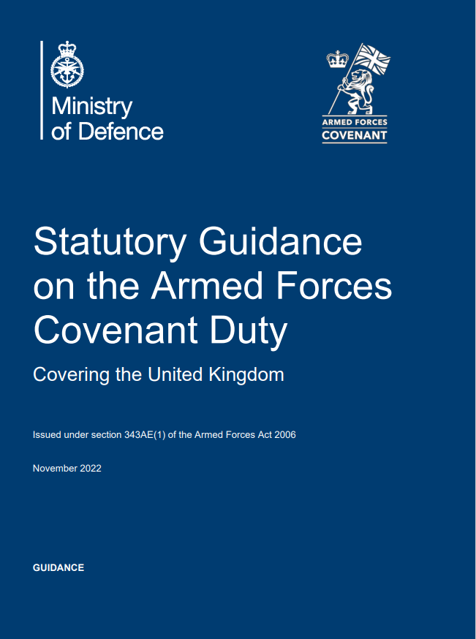
Covenant Duty Statutory Guidance
Why a Statutory Guidance document?
To improve the Armed Forces’ lived experience, by increasing awareness of disadvantages they can face and how they can be resolved.
The Armed Forces Act provides for a Statutory Guidance document to be published.
To increase understanding of, and compliance with, the Duty, by creating a legal requirement for bodies to have regard to it.
To explain everything you need to know about the new Duty, in plain English (and Welsh).
https://www.gov.uk/government/publications/armed-forces-covenant-duty-statutory-guidance
Notes:
First of all: Why a Statutory Guidance document?
The Armed Forces Act provides for a Statutory Guidance to be published, and it has an implied expectation that one will be published.
In fact the organisations in scope of the Duty are legally required to pay regard to this Statutory Guidance document, when carrying out the relevant activities.
And we need a document, focussed on the Duty, that explains what the law requires, and how it can be implemented in practice. The Armed Forces Act itself has to be written in legalese that can be hard to understand, so the Statutory Guidance translates the legal requirement into plain English.
Therefore, by creating a document that clearly explains what the law requires, and that the affected bodies are legally required to pay attention to, we should increase understanding of the Duty, and compliance with it.
So, by increasing understanding of the Covenant, and how it can be applied in practice, and how disadvantages can be removed, we will hopefully achieve the ultimate aim, which is to improve the Armed Forces’ lived experience.
Now, to show you what is in the Statutory Guidance…

Slide 30
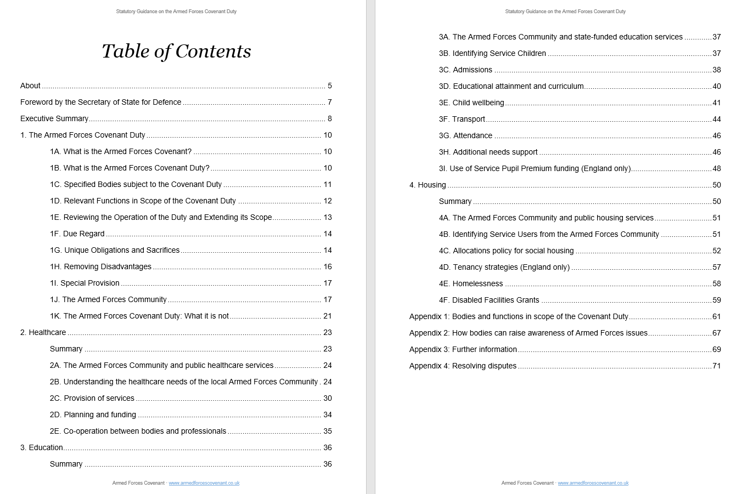
What is in the Statutory Guidance?
2-page Exec Summary
What is the Duty?
Who’s in scope & when?
Key terms
Application in the field of housing
Application in the field of healthcare
Application in the field of education
Notes:
What is in the Statutory Guidance?
Here’s the Contents page.
The first thing to highlight is there’s a 2-page Executive Summary that summarises the Duty on a couple of sides.
Chapter 1 explains what the Duty is, when it applies, who’s in scope & when, and explains the key terms, such as ‘unique obligations and sacrifices’, and who the Armed Forces community is, and so on.
Chapters 2, 3 and 4 then describe how it can be implemented in practice, in the three fields that are in scope – healthcare, education and housing.
All 3 chapters have the same layout, and I’d like to show you the first few pages of one of those chapters, so you can see what that looks like in practice.

Slide 31
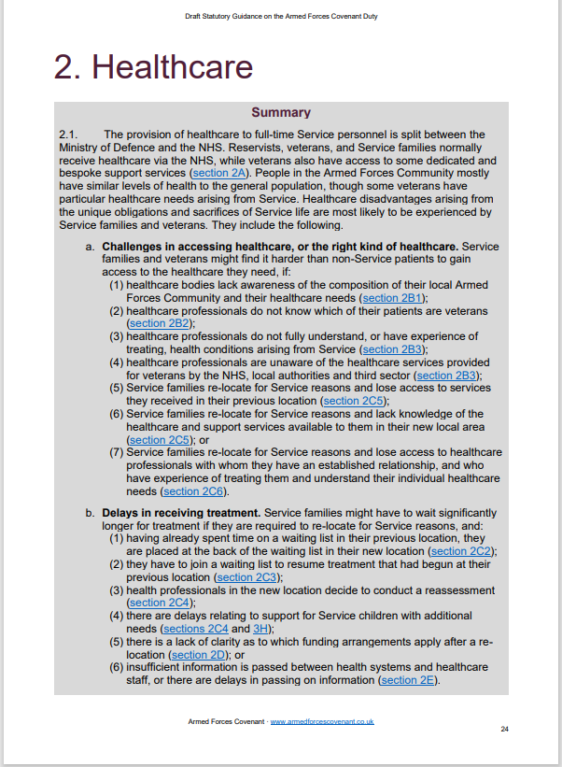

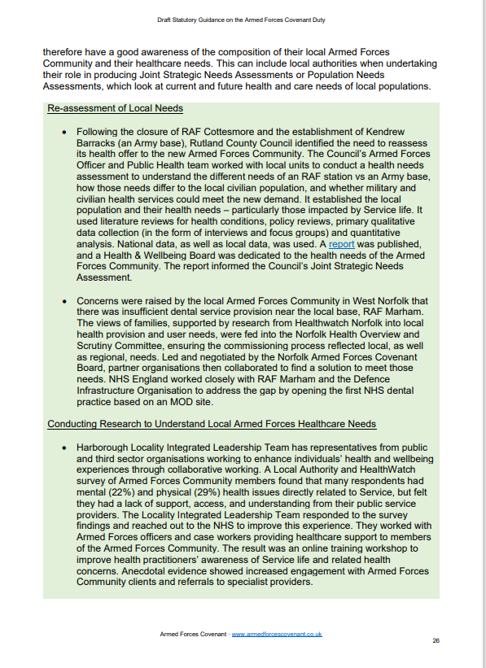
What is in the Statutory Guidance?
Context
Descriptions of disadvantages
1-page summary of chapter
Descriptions of case studies to mitigate disadvantages or apply special provision
Other relevant codes, legislation, etc
Notes:
HEALTHCARE CHAPTER.
This is a screenshot of the first 3 pages of the Healthcare chapter.
First there’s a 1-page summary of the whole chapter.
Then the first section in the chapter provides background and context of how the Armed Forces Community interacts with this area of public service provision.
Then the rest of the chapter contains 3 elements:
- descriptions of disadvantages for the AF Community, that arise from Service life,
- descriptions of case studies to mitigate these or apply special provision, and
- links to other relevant codes of practice, statutory guidance, and the like, if they refer to the Armed Forces
That brings us to the end of the Statutory Guidance slides.

Slide 32
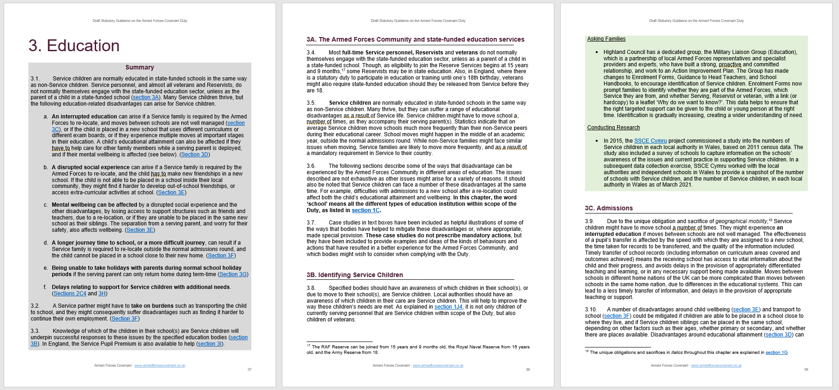
What is in the Statutory Guidance?
Descriptions of case studies to mitigate disadvantages or apply special provision
Context
Descriptions of disadvantages
Other relevant codes, legislation, etc
1-page summary of chapter
Notes:
EDUCATION CHAPTER.
This is a screenshot of the first 3 pages of the Education chapter.
First there’s a 1-page summary of the whole chapter.
Then the first section in the chapter provides background and context of how the Armed Forces Community interacts with this area of public service provision.
Then the rest of the chapter contains 3 elements:
- descriptions of disadvantages for the AF Community, that arise from Service life,
- descriptions of case studies to mitigate these or apply special provision, and
- links to other relevant codes of practice, statutory guidance, and the like, if they refer to the Armed Forces
That brings us to the end of the Statutory Guidance slides.

Slide 33
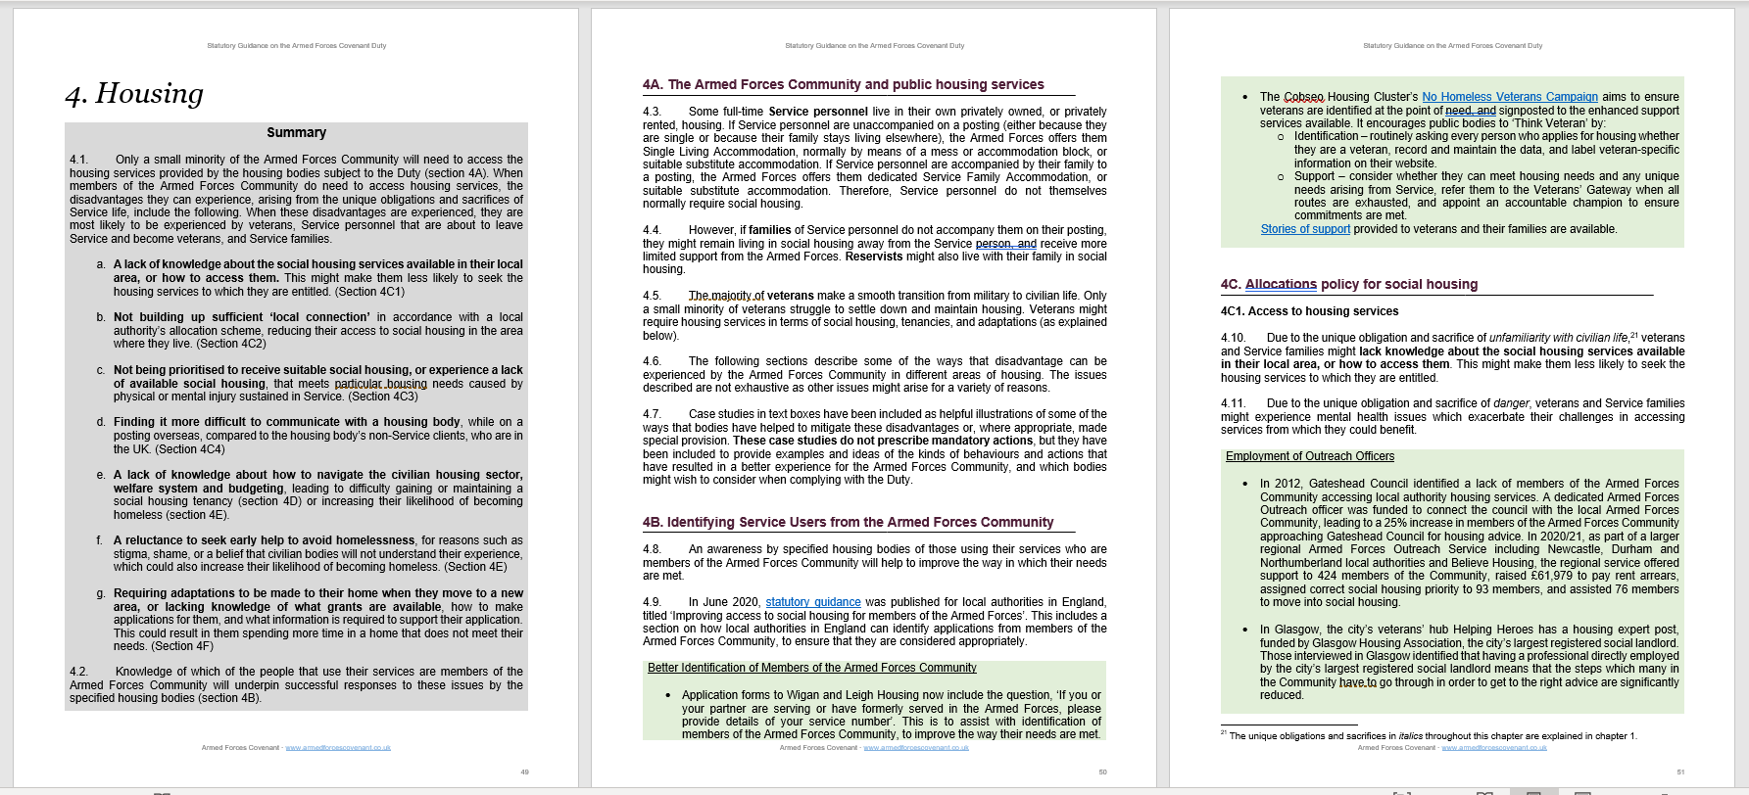
What is in the Statutory Guidance?
Context
Descriptons of disadvantages
Other relevant codes, legislation, etc
1-page summary of chapter
Descriptions of case studies to mitigate disadvantages or apply special provision
Notes:
HOUSING CHAPTER.
This is a screenshot of the first 3 pages of the Housing chapter.
First there’s a 1-page summary of the whole chapter.
Then the first section in the chapter provides background and context of how the Armed Forces community interacts with this area of public service provision.
Then the rest of the chapter contains 3 elements:
- descriptions of disadvantages for the AF Community, that arise from Service life,
- descriptions of case studies to mitigate these or apply special provision, and
- links to other relevant codes of practice, statutory guidance, and the like, if they refer to the Armed Forces
That brings us to the end of the Statutory Guidance slides.

Slide 34
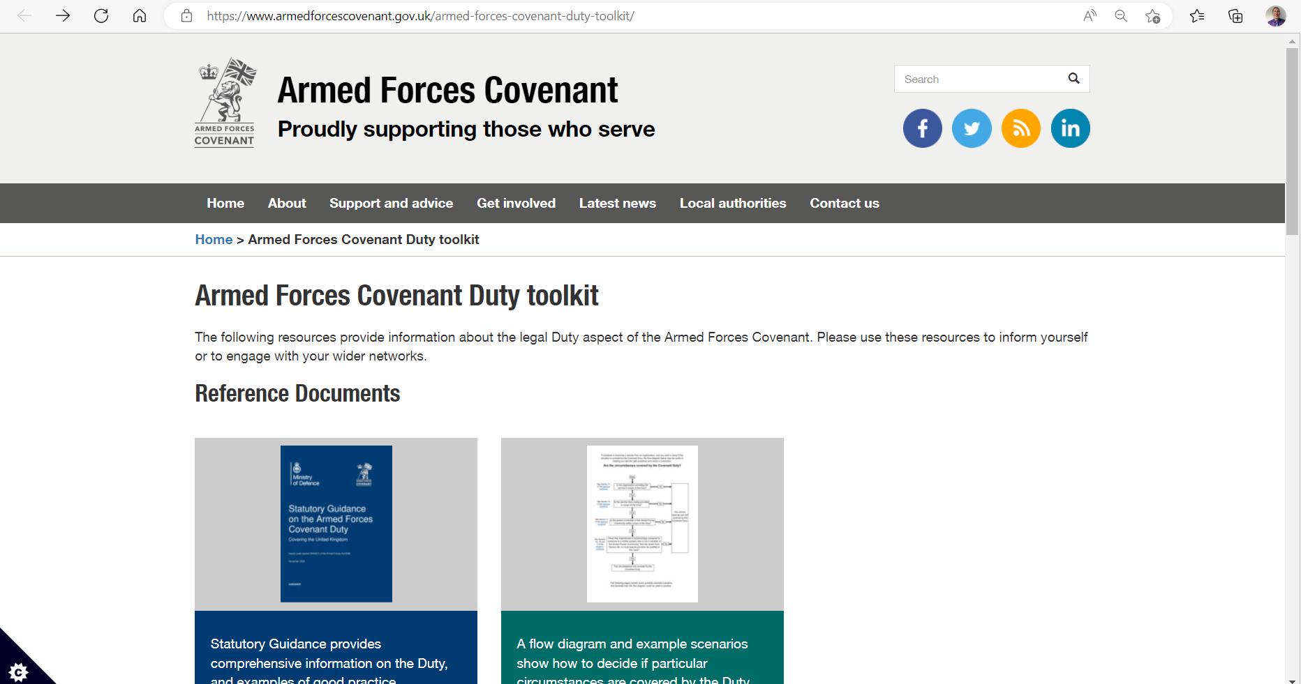
How do I find out more about the Duty?
https://www.armedforcescovenant.gov.uk/armed-forces-covenant-duty-toolkit/
Notes:
The Covenant team has published a Covenant Duty toolkit on the Armed Forces Covenant website, the link is included in this presentation pack.
The toolkit is a very useful resource, aimed at helping those who have to consider the Covenant in their area of work.
It contains a range of resources that provide information about the legal Duty aspect of the Armed Forces Covenant, including:
links to reference documents such as the Statutory Guidance
access to quick guides that explain the Duty more briefly
links to relevant YouTube videos
training resources that can be used to inform yourself or to engage with your wider networks
The Covenant team will be adding to this toolkit in the coming weeks as additional resources come on stream. Please contact us if there’s anything else you would like us to include in the toolkit.
It would be good practice to check the toolkit for any new material from time to time or as dipping in & out of the resources on offer.

Slide 35

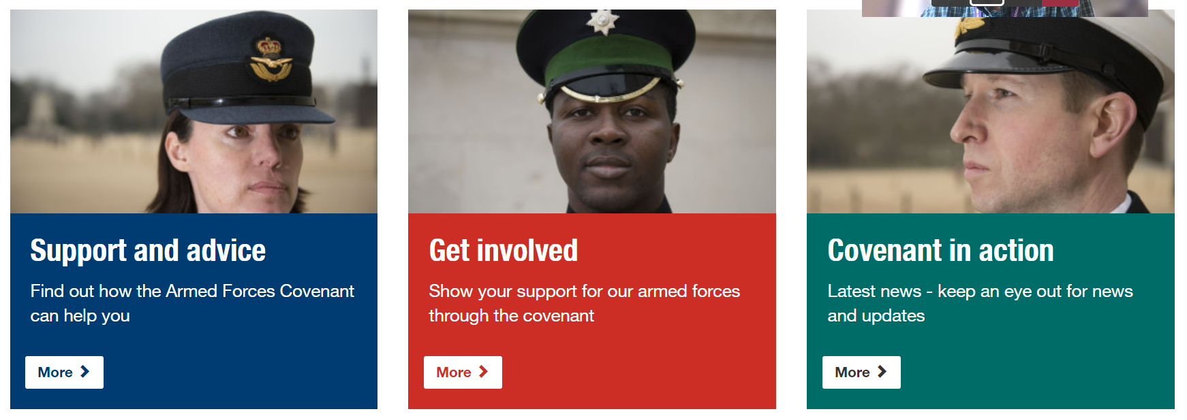
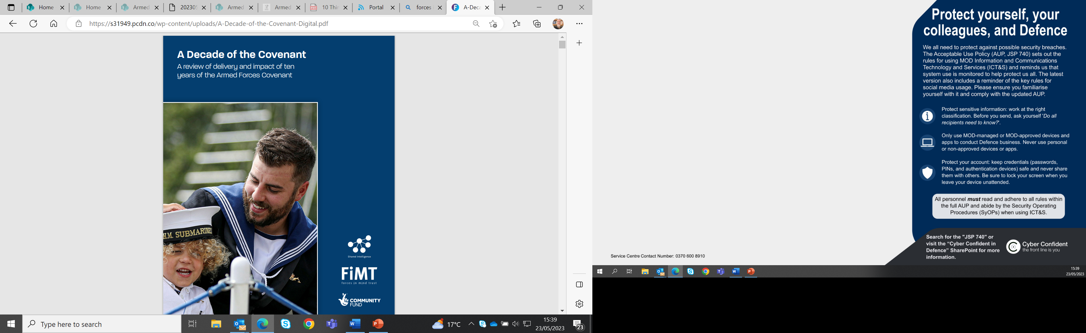



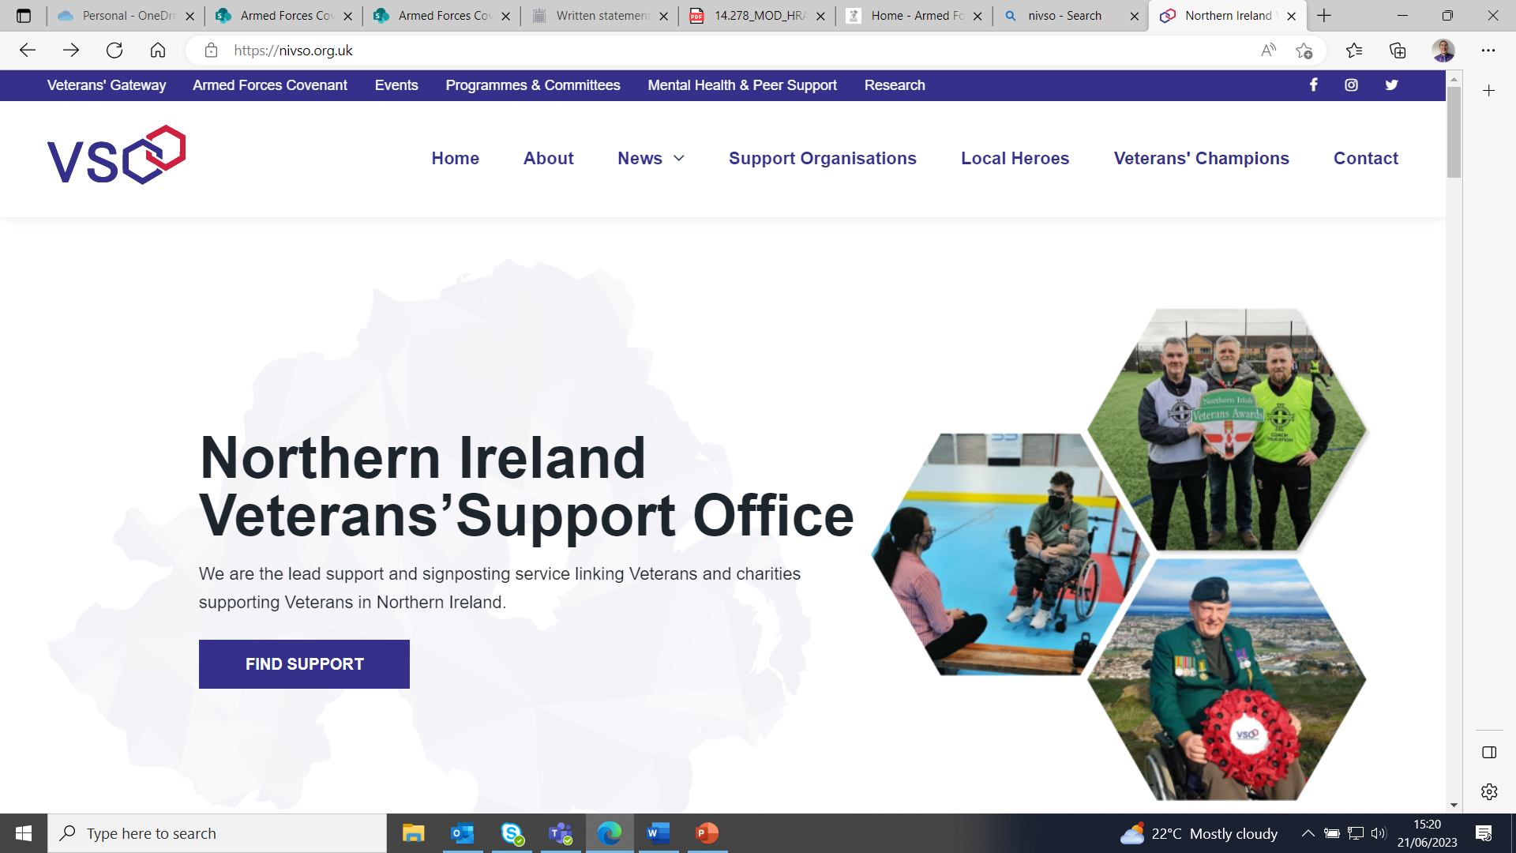
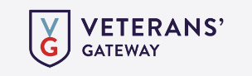
Other Support
Notes:
In addition to the Guidance, there is lots of other support available to help in-scope bodies implement this Duty.
The Covenant Annual Reports provide useful information on Covenant and examples of its implementation. It sets out major achievements and highlights remaining challenges and new commitments.
The Covenant website contains useful resources and tools. The news brief can be found at the tab for latest news and includes useful links including one to the draft statutory guidance.
The Armed Forces Covenant Fund Trust Knowledge network shares good practice and knowledge of those who have received grants from the Covenant Fund Trust.
E-learning materials, Warwickshire County Council has created an e-learning programme which anyone can access via a link on the news brief and elsewhere on the Covenant webpages.
[Ombudsman Guidance, for example the Local Government & Social Care Ombudsman has information on their webpages, there are other Ombudsman across UK.
Defence Relationship Management partners with organisations throughout the UK, helping them understand the value of signing the Covenant and building mutually beneficial partnerships with Defence. It provides support on employing members of the Armed Forces community.
A series of reports funded by the Forces in Mind Trust – Our Community Our Covenant Reports and A Decade of the Covenant – provide an independent overview of the Covenant in practice at the local level, identifying issues of concern to the AF Community, good practice, key local infrastructure –such as dedicated webpage and published action plan - and a self-assessment toolkit to allow those delivering the Covenant to consider their own performance.

Slide 36

Any Questions?
www.armedforcescovenant.gov.uk
COVENANT-MAILBOX@mod.gov.uk

