Slide 1


The Armed Forces Covenant Legal Duty extension

Slide 2
The Armed Forces Covenant Legal Duty extension
1. Duty extension update
2. Interactive quiz
Notes:
The plan for this session is, first a brief update on the work to extend the Armed Forces Covenant Legal Duty.
We will then have an interactive quiz.
So first, an update on the Armed Forces Covenant Legal Duty extension.

Slide 3
Covenant Legal Duty now
 | Any function, such as
 | Making decisions about individual members of the AF Community
 | Planning, funding & delivering services
 | Developing a policy
 | Overseeing other organisations
 | Enacting or implementing legislation
 | Setting standards
 | Issuing guidance
 | Bodies
 | Local authorities
 | NHS bodies
 | State-funded schools
 | Policy area
 | Healthcare (specifically: provision of services, planning & funding, co-operation between bodies)
 | Education (specifically: admissions, attainment, well-being, transport, attendance, additional needs, SPP)
 | Housing (specifically: social housing, homelessness, Disabled Facilities Grants)
in the fields of
When
exercise
they must have due regard to Covenant principles.
It came into force in November 2022.
Notes:
We start by explaining what the Duty is already, right now, by building a sentence on the screen which summarises the current Duty.
So, first, it applies to certain bodies in the public sector: local authorities, NHS bodies, and state-funded schools.
And whenever one of these bodies does anything (the legal phrase is: exercises a function), such as, for example, …………
…when one of these bodies does this in certain, specific, fields: Within healthcare, it’s specifically …………, Within education, it’s specifically …………, Within housing, it’s specifically …………,
…then it must have due regard to Covenant principles.
And that is the current Covenant Legal Duty in a nutshell.
It’s been in force since November 2022.
I’d like to explain more about this phrase ‘due regard to Covenant principles’.

Slide 4
‘Due regard to Covenant principles’
What is ‘due regard’?
It’s an obligation to consciously consider the Covenant principles.
It means placing appropriate weight on the Covenant principles when all relevant factors are considered.
It does not mean that any particular conclusions have to be reached, or specific public service delivery outcomes achieved.
Bodies should take the same action as for other ‘due regard’ duties, such as PSED and Prevent.
What are the Covenant principles?
The Covenant is the statement of the moral obligation between the country and its Armed Forces community.
The unique obligations and sacrifices made by the Armed Forces community.
No disadvantage arising from Service for the Armed Forces community, compared to the general population.
Special provision can be appropriate, especially for those sacrificing the most (the injured and bereaved).
Notes:
What does ‘due regard’ mean? ‘Due regard’ means actively taking the Covenant principles into account, consciously considering them, and putting fair weight on them, when you make decisions, and it means genuinely trying to implement the principles if you can, taking everything else into account.
The term ‘due regard’ wasn’t invented for the Covenant Legal Duty.
It was already an established legal concept.
The Public Sector Equality Duty and the Prevent Duty are also duties of due regard, so whatever you do to implement those other duties, it would make sense to treat the Covenant Duty the same way.
And what is it you have to have due regard to?
The Covenant statement outlines the moral obligation the nation has towards its Armed Forces community. And its principles are that:
recognising the unique obligations and sacrifices made by the AF community,
there should be no disadvantage arising from Service for the AF community, compared to the general population,
and special provision can be appropriate, especially for those sacrificing the most, which usually means the injured and bereaved.
These can feel a bit abstract. It’s always easier to understand what these principles mean in practice through examples. The interactive quiz a bit later will bring them to life.

Slide 5
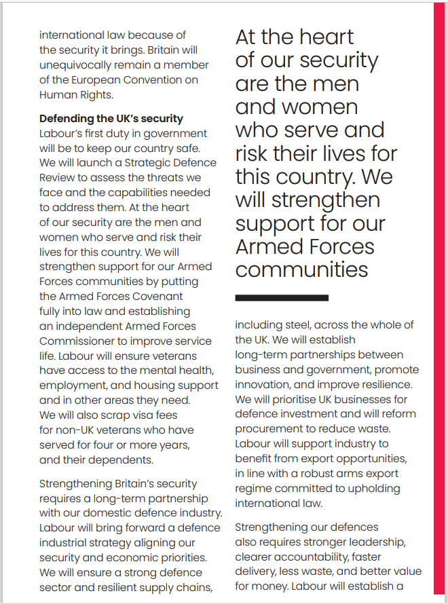
Covenant Legal Duty future
We will strengthen support for our Armed Forces communities by putting the Armed Forces Covenant fully into law
 | Policy areas
 | Healthcare
 | Education
 | Housing
 | Employment
 | Social care
 | Childcare
 | Welfare benefits
 | Pensions
 | Personal taxation
 | Criminal justice
 | Immigration
 | Citizenship
 | Service-related compensation
 | Transport
This means:
It will stay a duty of due regard to Covenant principles.
Bringing UK Government departments & Devolved Governments into scope (in addition to the local bodies).
More policy areas to be covered.
Each policy area will be covered in a much broader way.
Notes:
So that’s the Legal Duty now. Let’s look at how the Duty is going to change.
We start from the Government’s election manifesto. This is a page from it. It said, quote “We will strengthen support for our Armed Forces communities by putting the Armed Forces Covenant fully into law.”
Ministers have decided this means:
- It will stay a duty of due regard to Covenant principles.
- UK Government departments and the Devolved Governments will be brought into scope.
- It will cover more policy areas. Ministers decided they wanted to take a (quote) “maximalist approach”, so in addition to healthcare, education and housing, they’ve decided it will cover……..
- and these policy areas will be covered in a much broader way than currently. If you remember, the current Duty applies to specific elements of healthcare, education and housing, those restrictions will be removed, and the Duty will instead apply in these broad fields.

Slide 6
Stakeholder engagement programme
To decide what the additional policy areas should be, we conducted an extensive stakeholder engagement exercise with >150 organisations, including:
UK Government departments
Devolved Administrations
Local authorities
Military charities
Families Federations
Single Service representatives
NHS Trusts
Academics
Forces in Mind Trust
Defence Bereaved Families Group
Businesses awarded the Employer Recognition Scheme gold award
Written evidence about the Covenant previously submitted by stakeholders to Parliamentary committees
Notes:
How did we come up with these policy areas?
Last autumn, the MOD spent several months running an extensive stakeholder engagement programme.
We engaged with more than 150 organisations, including service deliverers, representatives of the Armed Forces community, academics, policy experts, and so on.
A set of policy areas came up consistently as the most important ones in affecting the Armed Forces’ quality of life, so those are what’s going into the extended Duty.

Slide 7
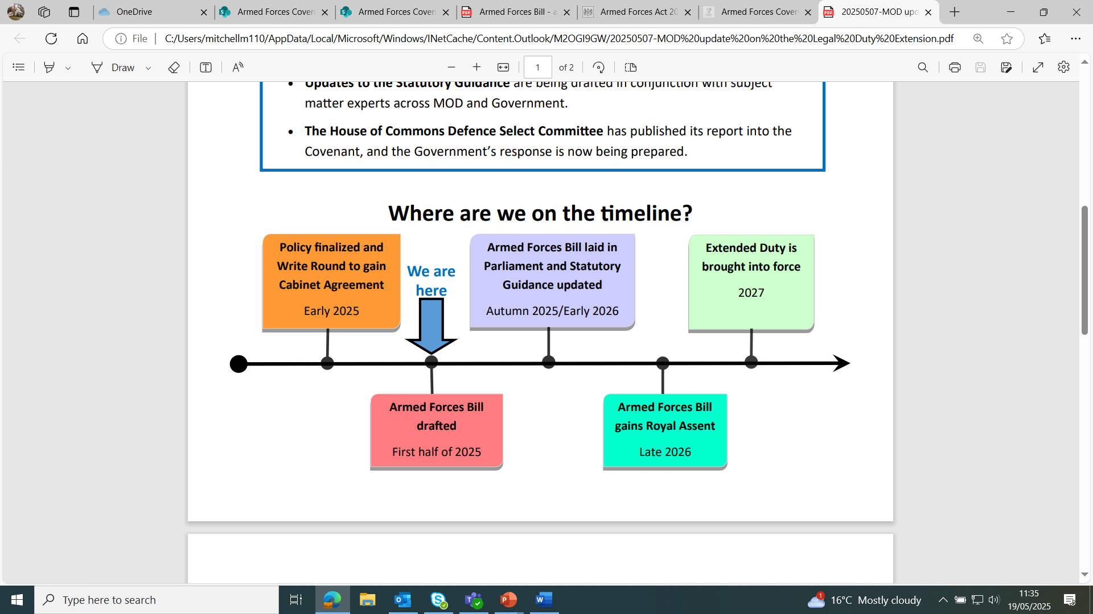
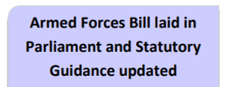
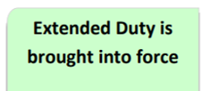


Roadmap
Notes:
In terms of the roadmap of the steps that need to be completed.
We’ve completed policy finalisation and gained Cabinet agreement through Write Round. These changes to the Duty were publicly announced by the Prime Minister last week.
This change to the Duty will be in an Armed Forces Bill, and those Covenant Bill provisions are now being drafted.
The Armed Forces Bill is then laid in Parliament, and updated statutory guidance will also be published.
After going through all its Parliamentary stages, the bill then gains Royal Assent, and the extended Duty will be brought into force a few months after that.

Slide 8
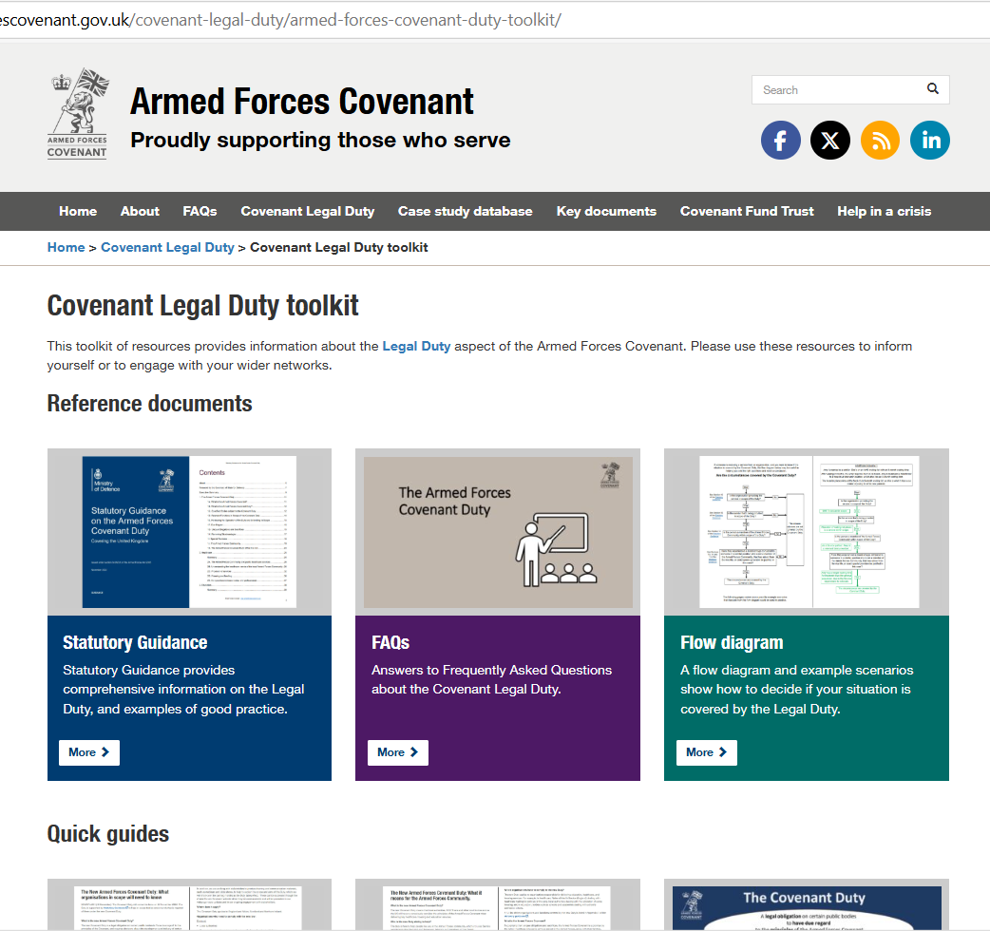
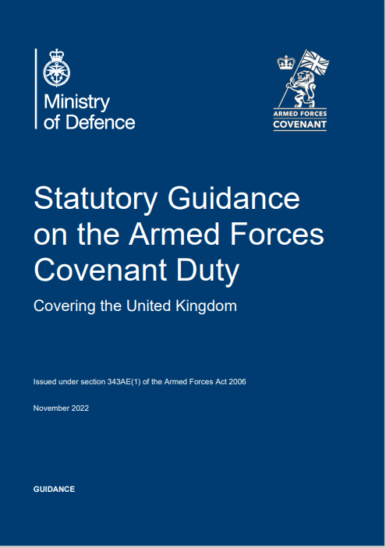
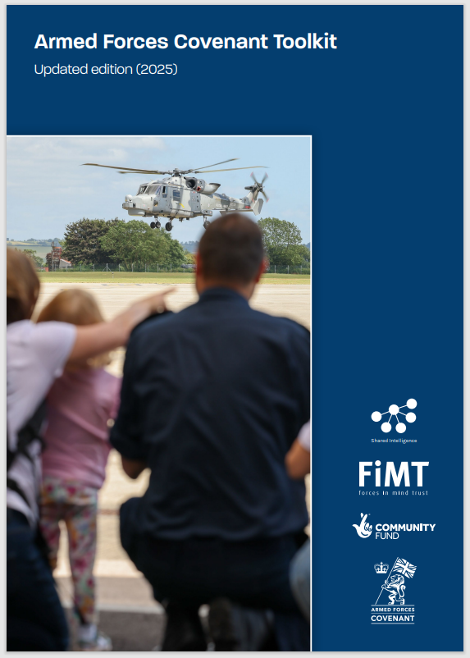
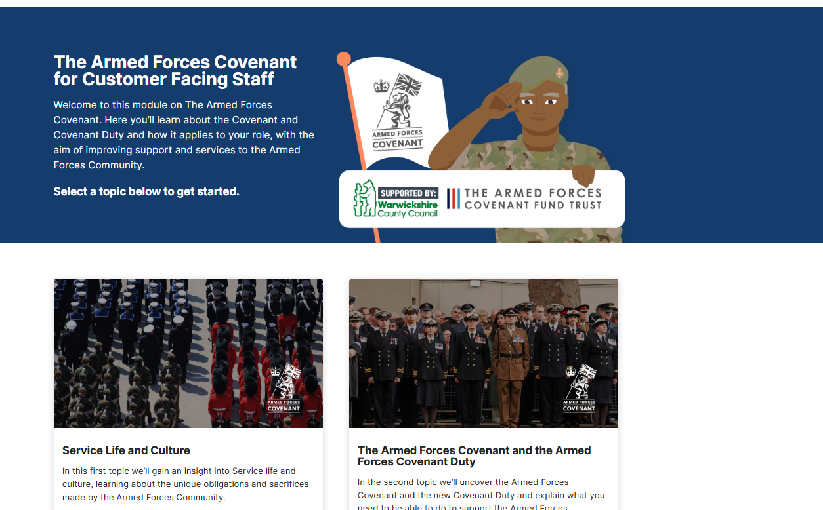
Sources of more information
Notes:
Where can you find out more?
The statutory guidance,
Will be updated and published. This is a really key document. It explains what the Duty means in practice, and it has the weight of Parliamentary endorsement.
It will have a section on each of the new policy areas.
It explains, in plain English, how Covenant disadvantage has arisen or could potentially arise in each policy area, and how special provision can be implemented.
Its purpose is not to assess if there is disadvantage or special provision, this will vary from organisation to organisation, and over time as well.
Its purpose is to help everyone correctly understand what would constitute Covenant disadvantage and special provision in each policy area, so you can then assess if they exist in practice in a particular organisation, and take appropriate action.
Our website, armedforcescovenant.gov.uk, has a Legal Duty toolkit, and lots of resources such as FAQs, quick guides, training materials, and so on.
Through our website you can access our Annual Report, outlining Covenant developments over the past year.
I would also recommend the Covenant toolkit, published by the Forces in Mind Trust, which outlines a Core infrastructure that will help you deliver the Covenant. And it provides a self-assessment tool, that you can use to assess if you have the basics in place. As we heard yesterday, a new updated version for 2025 was published last week, reflecting the latest developments in the Duty.
And then there’s also some training packages on the Covenant that have been put together by other organisations, in particular I would highlight:
the Warwickshire Council e-learning package, and
the Herefordshire and Worcestershire e-learning package, all of which are suitable for a wide general audience, not just people in those counties.
All these resources can be accessed through our website.

Slide 9
What can you do?
Continue highlighting examples of disadvantage and special provision to us.
Continue working to remove disadvantage and offer special provision in all policy areas.
Take part in our stakeholder engagement on the draft updated statutory guidance, later this year.
If you work for a body subject to the Duty, look at whether your decisions and policies in the relevant policy areas include explicit consideration of the Covenant.
Tell us what training and support would benefit you most.
  For example: webinars, quick guides, FAQs, website updates, published guidance, case studies, ‘train the trainer’ sessions, peer to peer sharing of best practice…?
Find out about the latest Covenant developments by regularly visiting our website armedforcescovenant.gov.uk and our latest news feed.
Send queries to our team using the Contact Us form on our website.

Slide 10
Interactive quiz
Please form small teams around your tables.
1 person from each team to access slido.com
Join as a participant, enter code # 3817 789
Please enter the name of your organisation as your team's name.
Notes:
So that brings us to the end of the update on the Covenant Duty extension.
We now come to the 2nd part of this session, the interactive quiz.

Slide 11
Interactive quiz
Please form small teams around your tables.
1 person in each team to access slido.com
Join as a participant, enter code # 3817 789
Please enter the name of your organisation as your team's name.

Slide 12
Interactive quiz
Please form small teams around your tables.
1 person in each team to access slido.com
Join as a participant, enter code # 3817 789
Please enter the name of your organisation as your team’s name.
The Covenant principles
Recognising the unique obligations and sacrifices made by the Armed Forces community:
No disadvantage arising from Service for the Armed Forces community, compared to the general population.
Special provision can be appropriate, especially for those sacrificing the most (the injured and bereaved).
Notes:
I’m going to give you a series of scenarios. For the first few I’ll ask you if they’re Covenant disadvantage or not, and for the last few I’ll ask you if they’re Covenant special provision or not.
To remind you what we’re looking for, the Covenant principles are that…

Slide 13
Question 1
Amy’s partner is in the RAF. Amy is on an NHS waiting list with an 8-month wait time.
After waiting 4 months, the RAF re-locates them. Amy’s treatment is transferred to a hospital at their new location, which also has an 8-month wait time.
The hospital places Amy at the back of its 8-month waiting list, as this is what it does for all its new patients.
Is this Covenant disadvantage for Amy?
  Yes
  No – Amy is not herself in the Armed Forces.
  No – The hospital is treating Amy the same as everyone else.
Notes:
(B) Is not the right answer as family members are also covered by the Covenant.
(C) Is also not the right answer
Treating the Armed Forces the same as everyone else can still produce disadvantage.
Removing disadvantage is sometimes about treating the Armed Forces differently, so the outcome for them is the same as for everyone else.
The right answer is (A), Yes this is disadvantage.
What is the disadvantage?
She has to wait longer for treatment than similar people in the general population – 12 months rather than 8.

Slide 14
Question 2
Deena is an Army Reservist. She’s in the middle of a course of NHS orthodontic treatment when she re-locates across the country to care for an elderly relative.
No NHS dentists in her new location have availability, so she travels back to her original NHS dentist several times to complete the treatment.
Is this Covenant disadvantage for Deena?
  Yes
  No – It hasn’t been caused by Service.
  No – Deena has completed the treatment uninterrupted.
Notes:
(C) is not the right answer
the fact she’s completed the treatment uninterrupted doesn’t stop it being disadvantage
if the Armed Forces take mitigating action to prevent one disadvantage arising, they’re still likely to be put out in other ways, such as loss of time, or extra travel expenses.
(B) is correct.
The Covenant’s moral obligation is that disadvantage should not arise from Service life, so something is only a Covenant issue, a Covenant disadvantage, if it’s been caused by Service, and this hasn’t been.
This example is quite obviously not caused by Service, but it’s not always that obvious. Sometimes it can be quite hard to decide whether it’s caused by Service or not, especially if they’re a veteran who left the Armed Forces decades ago.
And people present with all sorts of issues, and digging to find out whether their issue has been caused by Service is actually a really important step in understanding if it’s a Covenant issue.

Slide 15
Question 3
Sam is the 15-year-old child of an RAF pilot. He lives with his parents in Cyprus, where they’re posted.
The posting ends; they return to the UK.
Sam’s new school uses some different GCSE exam boards to his MOD school in Cyprus.
He finds he’s studied a different set of exam topics to his new classmates.
Is this Covenant disadvantage for Sam?
  Yes
  No – He has as many lessons as everyone else.
  No – Non-military children also sometimes move school.
Notes:
(B) Is not the right answer, this isn’t about how many lessons he has in total, but about how prepared for his GCSEs he is.
(C) Is not the right answer, this doesn’t stop it being a Covenant disadvantage, as experiences don’t have to be unique to the Armed Forces to be disadvantages.
The right answer is (A), Yes this is disadvantage.
What is the disadvantage?
He has fewer lessons on his GCSE topics – that’s true whichever board’s exams he takes.

Slide 16
Question 4
Will is currently serving in the Royal Marines. His family is moving house.
He wants to take leave to help them move, but his request to take leave is denied, so he goes AWOL to help them move.
When he returns to base, he’s arrested.
He complains if he worked in civvie street he wouldn’t be arrested for missing work.
Is this Covenant disadvantage for Will?
  Yes
  No – He could have hired house movers instead.
  No – This is part of the unique obligations and sacrifices of service life.
Notes:
(B) Is not the right answer, as he would still then have had that extra expense, so that doesn’t stop it being a disadvantage.
The correct answer is (C).
Being subject to Service law, such as AWOL offences, is certainly part of the unique obligations and sacrifices of service life.
It’s a necessary difference from the rest of society that enables the Armed Forces to function effectively.
It’s not a breach of our moral obligation.
It’s not a disadvantage which we should aim to remove.

Slide 17
Question 5
Paul’s father is a submariner in the Royal Navy. Due to long spells at sea, the family can’t take a holiday together in the upcoming half-term.
They ask Paul’s school for permission to take a term-time holiday.
The school’s attendance policy does not allow term-time holidays in any circumstances.
Is this Covenant disadvantage for Paul?
  Yes
  No – The school is treating Paul the same as everyone else.
  No – Paul’s education always takes priority.
Notes:
(B) Is not the right answer. As we said before, treating the Armed Forces the same as everyone else can still produce disadvantage.
(C) Is not correct,
Clearly his education is important, but spending time with his family is also important.
There’s a balance to strike,
Which is more important probably depends on a whole host of factors, such as how old Paul is, and what stage of education he’s at.
So it’s (A), this is Covenant disadvantage.
What is the disadvantage?
He can’t take a holiday with his parents but other children at the school can.

Slide 18
Question 6
A serving member of the RAF is posted to France for 2 years.
His partner Alex also moves to France with him.
Alex’s UK employer isn’t willing to even consider allowing full time remote working, so Alex has to resign.
Is this Covenant disadvantage for Alex?
  Yes
  No – Alex is choosing to move to France.
  No – Alex can find other work.
Notes:
(B) Is not the right answer.
The RAF needs this person to go to France, and it’s perfectly reasonable for his family to move with him.
(C) Is not the right answer.
While she might be able to find other work, that’s actually not going to be that easy, and she’s definitely lost out here, in terms of her employment.
So (A) is the correct answer.
It may or may not be possible for the employer to remove the disadvantage, it depends what sort of work it is.

Slide 19
Question 7
Ben is the husband of a member of the Army. They’ve moved house 10 times in the past 22 years.
When talking to some other military partners, Ben finds out he’s moved house more often than all the others.
Is this Covenant disadvantage for Ben?
  Yes
  No – Ben’s experience is quite common in the Armed Forces.
  No – Disadvantage is not about comparing groups within the Armed Forces.
Notes:
(B) is not the right answer,
the fact something happens frequently in the Armed Forces doesn’t stop it being a disadvantage.
The correct answer is (C),
the Covenant is not about comparing different groups in the Armed Forces with each other,
it’s about them getting a worse experience than what’s normal in the general population.
While moving house 10 times in 22 years is worse than normal in the general population, it’s part of the unique obligations and sacrifices of Service life. It’s a necessary difference from civilian life that can lead to disadvantage.

Slide 20
Question 8
James will soon leave the Navy. He wants to move into social housing after discharge.
However, he’s currently deployed to the Falklands, so cannot view available properties, sign a contract, or collect keys.
Also, the council’s computer system doesn’t register overseas addresses.
Therefore, he can’t progress his application.
Is this Covenant disadvantage for James?
  Yes
  No – The Covenant only applies to Armed Forces in the UK.
  No – The national shortage of social housing means it’s difficult for everyone.
Notes:
(B) Is not correct, the Covenant applies to the Armed Forces wherever they are located – in the UK or overseas.
(C) Is not the right answer.
While it is difficult for everyone to access social housing, it’s extra difficult for James,
He has extra difficulties that other people in the general population don’t have, which is the disadvantage here, so (A) is the correct answer.

Slide 21
Question 9
Farah is a veteran who lost both arms while serving in the Army 20 years ago.
He needs to have a blood sample taken.
The nurses are currently only trained to take blood from arms, so they undertake extra training so they can take blood from elsewhere on his body.
Is this Covenant special provision for Farah?
  Yes
  No – Farah doesn’t count as someone who ‘sacrificed the most’.
  No – This is removing a disadvantage.
Notes:
(B) is wrong, he does count as someone who’s sacrificed the most.
But that doesn’t mean everything done for him is special provision. Those who sacrifice the most can face disadvantage as much as anyone else. This is removing a disadvantage, so it’s (C).
The disadvantage would be that he can’t have a blood sample taken. The nurses are preventing that disadvantage from arising by undertaking the extra training.
The nurses aren’t giving him something better than everyone else gets, which would be special provision, they’re just bringing him back to the same level as everyone else, which is, he can have a blood sample taken, so it’s removing a disadvantage.

Slide 22
Question 10
MOD’s Armed Forces Bereavement Scholarship Scheme provides several different scholarships covering further and higher education.
These are for the children of Service personnel whose death is attributable to Service.
Is this Covenant special provision?
  Yes
  No – It’s removing a disadvantage.
  No – They’re still getting the same education as everyone else.
Notes:
(B) is wrong, it’s not removing a disadvantage,
(C) Is wrong, while they might still be getting the same education as everyone else, they’re getting it cheaper.
So this is for those sacrificing the most, and it’s giving them something better than is available to everyone else in the general population and the rest of the Armed Forces community, so this is special provision, so it’s (A).

Slide 23
Question 11
A business gives all the veterans it employs an extra day off on 11th November so they can attend Remembrance Day events.
Is this Covenant special provision?
  Yes
  No – Only the public sector can offer special provision.
  No – It’s neither removing disadvantage nor special provision.
Notes:
(B) is not correct, all organisations can offer special provision.
The correct answer is (C), this isn’t removing a disadvantage, and it isn’t special provision.
The Covenant’s moral obligation is to consider special provision for those giving the most, such as the injured and bereaved.
The Covenant doesn’t have any expectation of better treatment for everyone serving in the Armed Forces.
There’s no moral obligation to offer this extra day off, it’s just a nice thing to do. A lot of support to the Armed Forces Community doesn’t count as “Covenant” at all. This is one of those examples.
Support to the Armed Forces is much wider than the Covenant. Not everything is about the moral obligation.

Slide 24
Question 12
A local authority builds some social housing with special adaptations, reserved for injured veterans.
Is this Covenant special provision?
  Yes
  No – Other citizens also live in social housing.
  No – Other family members who haven’t been injured will also benefit.
Notes:
(B) is not the right answer, this definitely counts as something special, not available to the general population.
And (C) is also not the right answer. The fact that other family members will also benefit doesn’t stop it being special provision.
This is for those sacrificing the most, and it’s giving them something which is not available to the general population and the rest of the Armed Forces community, so this is special provision, so it’s (A).

Slide 25
The Armed Forces Covenant Legal Duty extension

